Slide 1
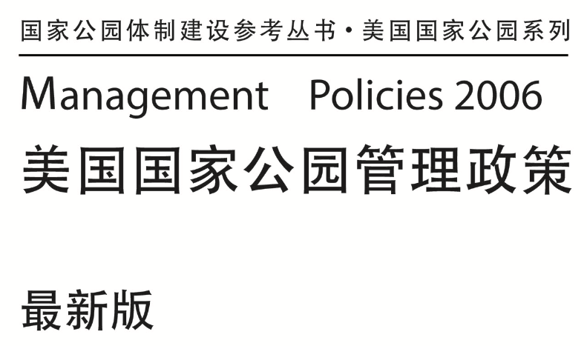
US National Park Service Management Policies
美国国家公园管理局管理政策

Slide 2
美国国家公园管理局管理政策
US National Park Service Management Policies
Enjoyment by present and future generations can be assured only if these special places are passed on to them in an unimpaired condition. And that is the challenge that faces all the employees of the National Park Service. It is a challenge eagerly embraced, but employees must have the tools required to perform the job successfully. The Management Policies contained in these pages represent one of the most important tools available. Through their judicious and consistent application, these policies will set a firm foundation for stewardship that will continue to earn the trust and confidence of the American people.

Slide 3
美国国家公园管理局管理政策
US National Park Service Management Policies
国家公园体系的创建,是为了保护这样一些地方免遭损害:其中
包含有众多世界上最壮丽的景观,有的铭刻着美国恒久奉行的原则,
有的则提醒着世人,为了捍卫这些原则,美国人民曾做出的巨大牺牲。
它们是全美国最卓越的休闲和学习之地。在这里,游客可以置身于历
史事件的实际发生地,还可以游赏全美国最具标志性的自然和历史名
胜。这些地方能让我们的身体、精神和思想焕然一新。根据 1916 年
《组织法案》的要求,必须用特殊的方式管理这些特殊地域——在这
种管理方式下,不仅此时此地的人能够享用这些地域,而且也能为未
来世世代代的人所享有。要确保当代与后代共同享有这些地域,就必
须将这些特殊地域在未受损害的状态下传递给后人,这正是国家公园
管理局全体员工所面临的挑战。我们热切地迎接这项挑战,但是,要
成功地完成工作,员工们就必须持有相应的工具。本手册所包含的政
策,就代表了我们所能得到的一些最重要的工具。通过审慎而持续地
应用这些政策,它们将为管理工作奠定坚实的基础,并将不断赢得美
国人民的信任和信心。

Slide 4
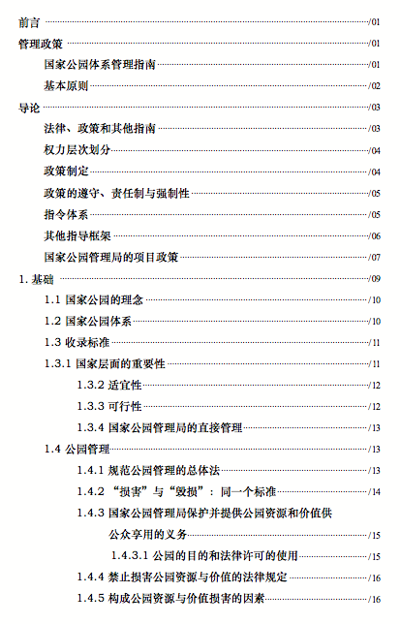
US National Park Service Management Policies

Slide 5
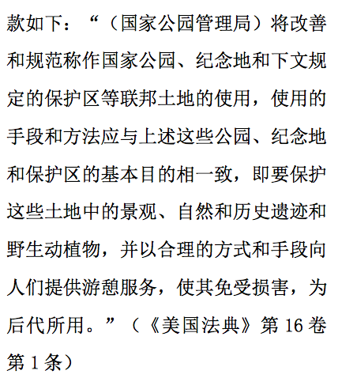
US National Park Service Management Policies
美国国家公园管理局管理政策
[The National Park Service] shall promote and regulate the use of the Federal areas known as national parks, monuments, and reservations hereinafter specified … by such means and measures as conform to the fundamental purpose of the said parks, monuments, and reservations, which purpose is to conserve the scenery and the natural and historic objects and the wild life therein and to provide for the enjoyment of the same in such manner and by such means as will leave them unimpaired for the enjoyment of future generations.

Slide 6
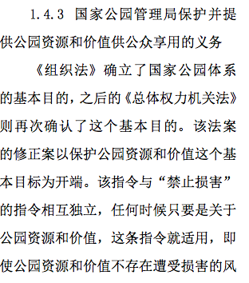
US National Park Service Management Policies: Conservation
美国国家公园管理局管理政策:保护资源
1.4.3 The NPS Obligation to Conserve and Provide for Enjoyment of Park Resources and Values
The fundamental purpose of the national park system, established by the Organic Act and reaffirmed by the General Authorities Act as amended, begins with a mandate to conserve park resources and values.

Slide 7
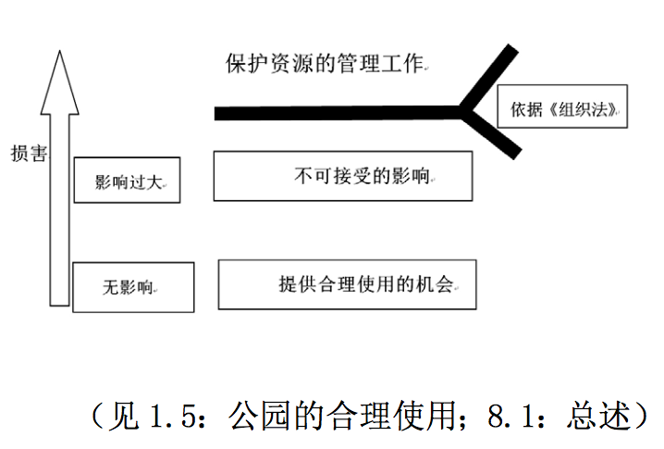
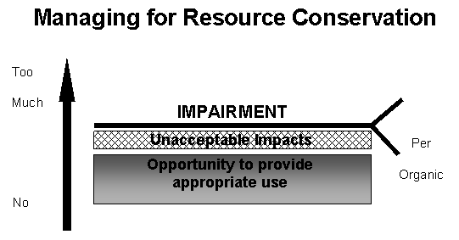
US National Park Service Management Policies: Impairment Determination
美国国家公园管理局管理政策:损害鉴定

Slide 8
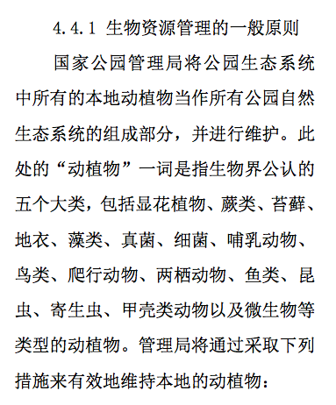
US National Park Service Management Policies: Biological Resources
美国国家公园管理局管理政策:生物资源管理
4.4.1 General Principles for Managing Biological Resources
The National Park Service will maintain as parts of the natural ecosystems of parks all plants and animals native to park ecosystems. The term “plants and animals” refers to all five of the commonly recognized kingdoms of living things and includes such groups as flowering plants, ferns, mosses, lichens, algae, fungi, bacteria, mammals, birds, reptiles, amphibians, fishes, insects, worms, crustaceans, and microscopic plants or animals.

Slide 9
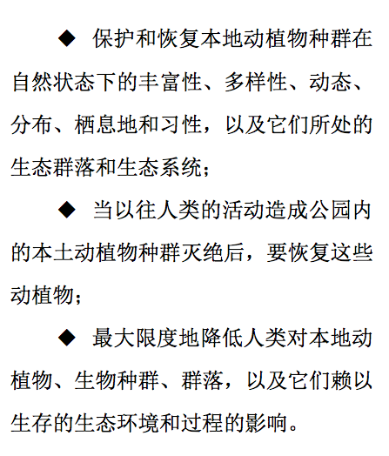
US National Park Service Management Policies: Biological Resources
美国国家公园管理局管理政策:生物资源管理
· preserving and restoring the natural abundances, diversities, dynamics, distributions, habitats, and behaviors of native plant and animal populations and the communities and ecosystems in which they occur;
· restoring native plant and animal populations in parks when they have been extirpated by past human-caused actions; and
· minimizing human impacts on native plants, animals, populations, communities, and ecosystems, and the processes that sustain them.

Slide 10
US National Park Service Management Policies: Cultural Resources
美国国家公园管理局管理政策:文化资源
The National Park Service will protect, preserve, and foster appreciation of the cultural resources in its custody and demonstrate its respect for the peoples traditionally associated with those resources through appropriate programs of research, planning, and stewardship.

Slide 11
US National Park Service Management Policies: Interpretation and Education
美国国家公园管理局管理政策:解说和教育
National parks are among the most remarkable places in America for recreation, learning, and inspiration. Interpretive programs are the methods the Service uses to connect people to their parks, with opportunities for all visitors to form their own intellectual, emotional, and physical connections to the meanings and values found in the parks’ stories. Facilitating those opportunities through effective interpretive and educational programs will encourage the development of a personal stewardship ethic and broaden public support for preserving and protecting park resources so that they may be enjoyed by present and future generations.

Slide 12
US National Park Service Management Policies: Visitation
美国国家公园管理局管理政策:探访
National parks belong to all Americans, and the National Park Service will welcome all Americans to experience their parks. The Service will focus special attention on visitor enjoyment of the parks while recognizing that the NPS mission is to conserve unimpaired each park’s natural and cultural resources and values for the enjoyment, education, and inspiration of present and future generations. The Service will also welcome international visitors, in keeping with its commitment to extend the benefits of natural and cultural resource conservation and outdoor recreation throughout the world.

Slide 13
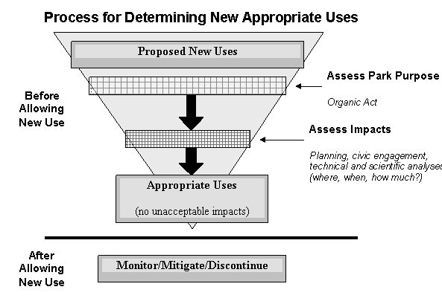
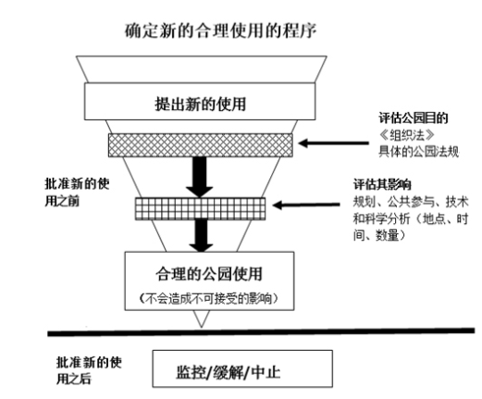
US National Park Service Management Policies: Appropriate Use
美国国家公园管理局管理政策:合理使用

Slide 14
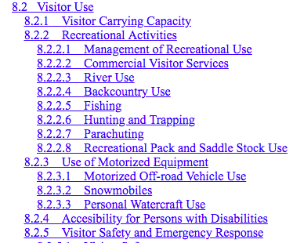
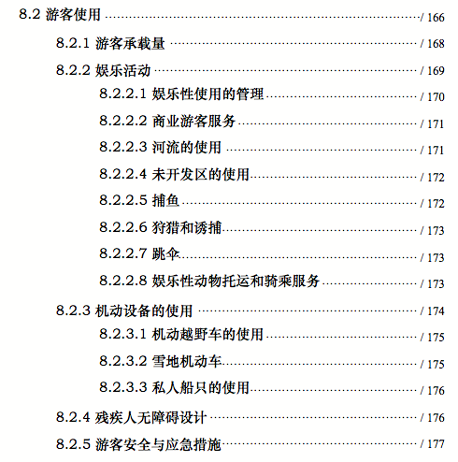
US National Park Service Management Policies: Visitor USe
美国国家公园管理局管理政策:游客使用

Slide 15
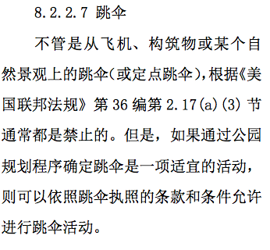
US National Park Service Management Policies: Example of Visitor Use
美国国家公园管理局管理政策:游客使用的例子
8.2.2.7 Parachuting
Parachuting (or BASE jumping), whether from an aircraft, structure, or natural feature, is generally prohibited by 36 CFR 2.17 9a) (3). However, if determined through a park planning process to be an appropriate activity, it may be allowed pursuant to the terms and conditions of a permit.

Slide 16
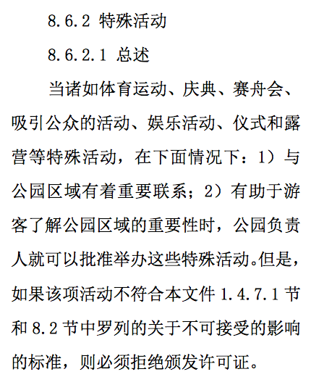
US National Park Service Management Policies: Special Events
美国国家公园管理局管理政策:特殊活动
8.6.2 Special Events
8.6.2.1 General
Special events—such as sports, pageants, regattas, public spectator attractions, entertainment, ceremonies, and encampments—may be permitted by the superintendent when (1) there is a meaningful association between the park area and the event, and (2) the event will contribute to visitor understanding of the significance of the park area. However, a permit must be denied if the event would be disallowed under the criteria listed for unacceptable impacts in sections 1.4.7.1 and 8.2.

Slide 17
US National Park Service Management Policies: Facilities
美国国家公园管理局管理政策:设施
The National Park Service will provide visitor and administrative facilities that are necessary, appropriate, and consistent with the conservation of park resources and values. Facilities will be harmonious with park resources, compatible with natural processes, esthetically pleasing, functional, energy- and water-efficient, cost-effective, universally designed, and as welcoming as possible to all segments of the population. NPS facilities and operations will demonstrate environmental leadership by incorporating sustainable practices to the maximum extent practicable in planning, design, siting, construction, and maintenance.

Slide 18
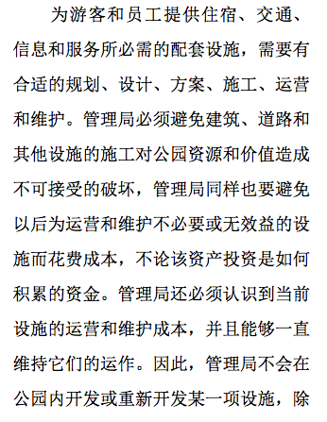
US National Park Service Management Policies: Facilities
美国国家公园管理局管理政策:设施
Support facilities necessary to house, transport, inform, and serve visitors and staff require proper planning, design, programming, construction, operation, and maintenance. The Service must avoid the construction of buildings, roads, and other development that will cause unacceptable impacts on park resources values. The Service must also avoid the future operation and maintenance costs of unnecessary or ineffective facilities, regardless of how the asset investment is funded.

Slide 19
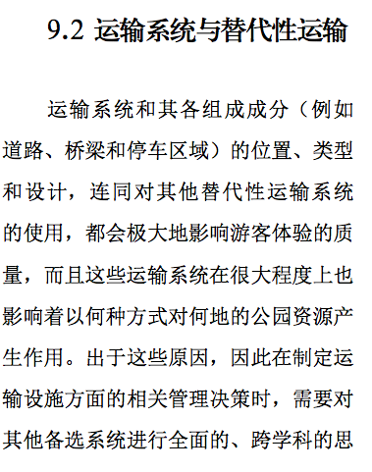
US National Park Service Management Policies: Transportation
美国国家公园管理局管理政策:交通
9.2 Transportation Systems and Alternative Transportation
The location, type, and design of transportation systems and their components (e.g., roads, bridges, trails, and parking areas), and the use of alternative transportation systems, all strongly influence the quality of the visitor experience. These systems also affect, to a great degree, how and where park resources will be impacted. For these reasons, management decisions regarding transportation facilities require a full, interdisciplinary consideration of alternatives and a full understanding of their consequences.

Slide 20
US National Park Service Management Policies: Roads
美国国家公园管理局管理政策:道路
9.2.1.1 Park Roads
Park roads will be well constructed, sensitive to natural and cultural resources, reflect the highest principles of park design, and enhance the visitor experience. Park roads are generally not intended to provide fast and convenient transportation; rather, they are intended to enhance the quality of a visit while providing for safe and efficient travel with minimal or no impacts on natural and cultural resources.

Slide 21
US National Park Service Management Policies: Commercial Services
美国国家公园管理局管理政策:商业性服务
Through the use of concession contracts or commercial use authorizations, the National Park Service will provide commercial visitor services that are necessary and appropriate for public use and enjoyment. Concession operations will be consistent to the highest practicable degree with the preservation and conservation of resources and values of the park unit. Concession operations will demonstrate sound environmental management and stewardship.
商业性游客服务

Slide 22
Weddings?
婚礼

Slide 23
Cattle Grazing?
放牧？

Slide 24
Pesticides?
除虫？

Slide 25
Drones?
无人机？

Slide 26
Bioprospecting?
生物探测？

Slide 27
Invasive Plant Control
外来植物控制

Slide 28
Climate Change?
气候变化？

Slide 29
Scientific Research?
科研？

Slide 30
US National Park Service Management Policies
美国国家公园管理局管理政策
Examples: 例子
Hunting 打猎
Mining 采矿
Collecting plants 收集植物
Burials 埋葬
Borrow pits 借土坑
Bicycles/Mountain Bikes 自行车/山地车
Plaques 饰板

Slide 31
Chinese Translation of the NPS Management Policies can be found at:
https://parks.berkeley.edu
美国国家公园管理局管理政策中文版下载网址

