Slide 1
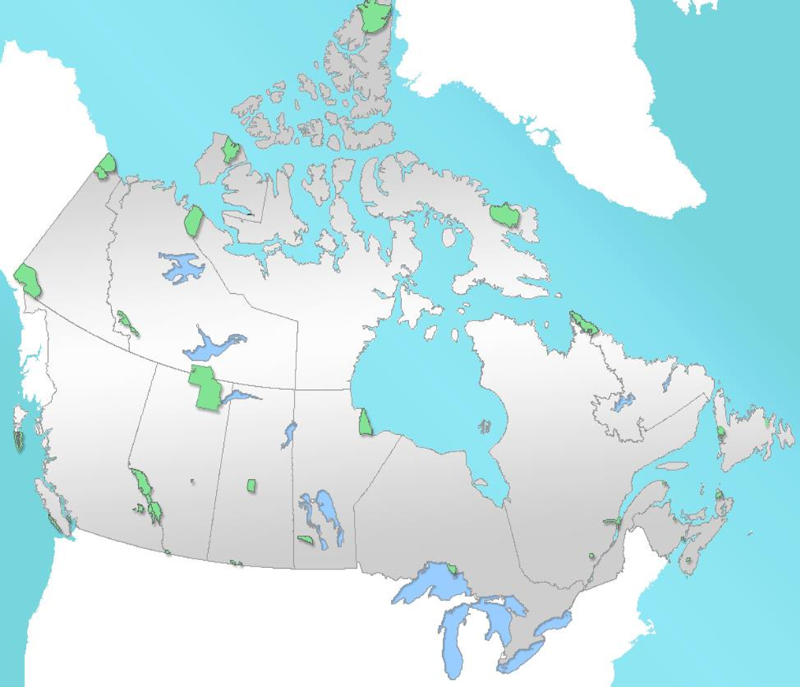
Establishing and Managing Canada’s Protected Areas
Michael Wong, (formerly) Executive Director, Ecological Integrity, Parks Canada
Regional Chair for North America, World Commission on Protected Areas, International Union for the Conservation of Nature (IUCN)
National Park Administration Training Program
University of California, Berkeley
Institute for Parks, People and Biodiversity
September 10, 2019

Slide 2
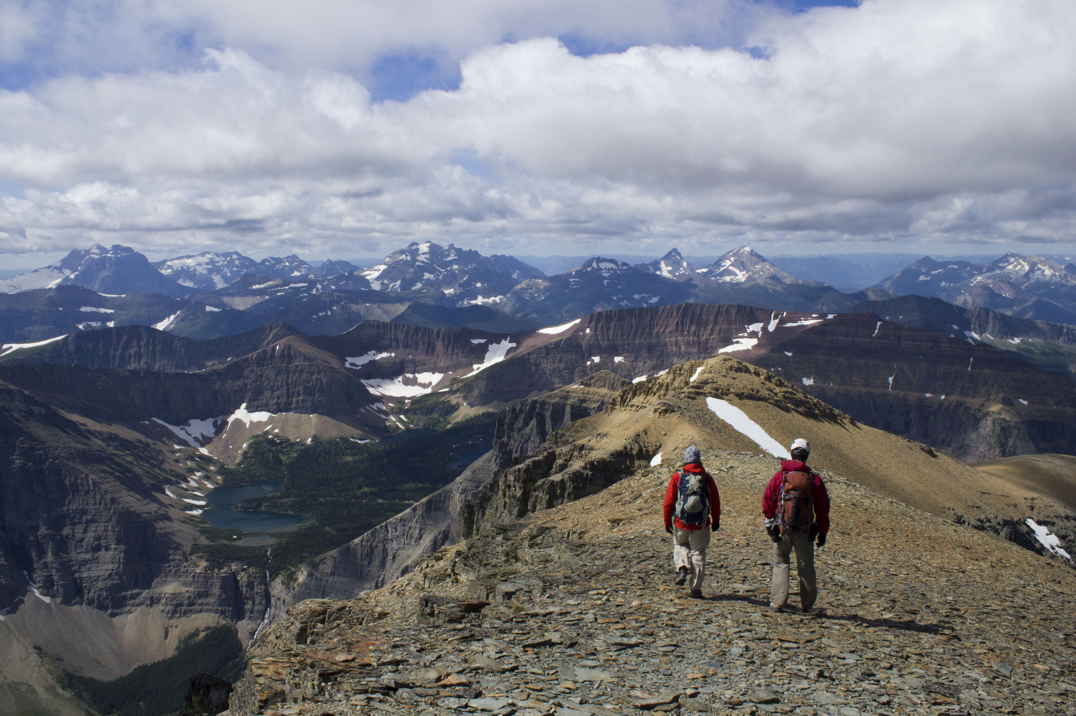
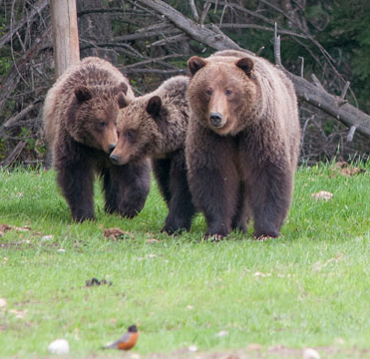
Presentation Contents
Overview of Canada and Parks Canada
History of Park Establishment and the National Park System Plan
Park Management Plan
Managing for Ecological Integrity
Monitoring and Reporting
Management Actions and Ecological Restoration
Climate Change and Parks

Slide 3
Second largest country in the world (9.98M square kilometers) 10 provinces and 3 territories Population (35.2M in 2016 census) Canada has the longest coastline in the world, with a total length of 243,042 kilometres (Pacific, Arctic, Atlantic Oceans) Forest, rivers and lakes, grasslands, Rocky Mountains, tundra, glacier

Slide 4
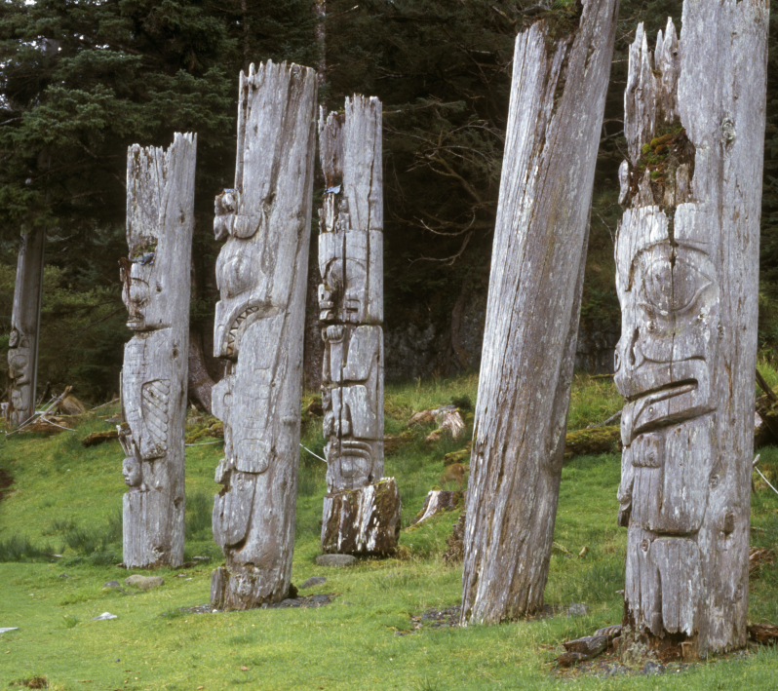
Parks Canada Overview (1)
- The largest federal land and asset managers (over 300,000 km²) with over 11,700 built assets in 216 locations, valued at $16 billion
- 46 National Parks, 5 National Marine Conservation Areas, 171 National Historic Sites, and 1 National Urban Park
- 12 UNESCO World Heritage Sites (e.g. Rocky Mountain Parks; Gros Morne; Skang Gwaay)

Slide 5
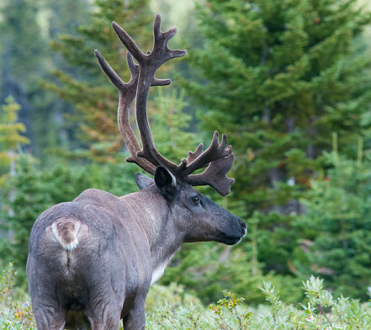
Parks Canada Overview (2)
Parks Canada administers:
328,198 sq km in 46 National Parks
124,740 sq km in 5 National Marine Conservation Areas
79 sq km in 1 National Urban Park
Quick Facts:
Banff was established in 1885
Canada’s national park system is now larger than Poland
Wood Buffalo National Park is larger than Switzerland
One of the world’s largest freshwater protected area is in Lake Superior
About half of Canada’s endangered species are found in national parks
Parks Canada welcomes over 23M visits per year

Slide 6
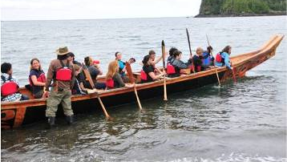
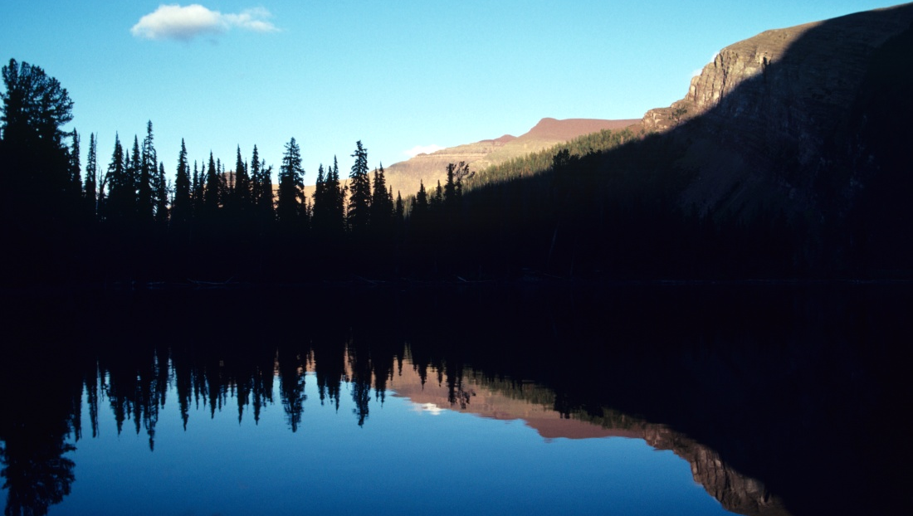
Parks Canada Mandate
Parks Canada’s mandate is to protect and present nationally significant examples of Canada’s natural and cultural heritage, and foster public understanding, appreciation and enjoyment for present and future generations
National parks are powerful and defining symbols of Canadian identity.
Parks Canada tells the story of Canada and brings our natural and cultural heritage alive

Slide 7
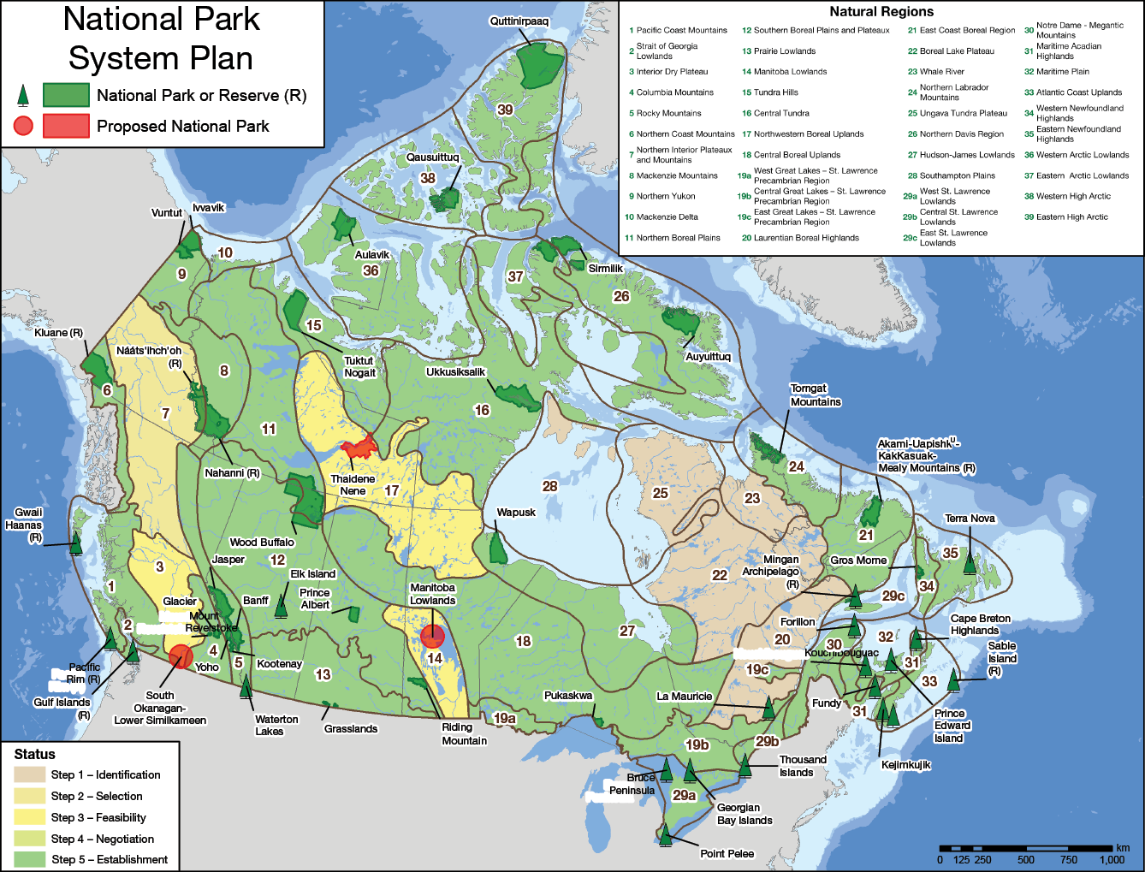
Notes:
Benefits of a systems plan for park establishment:
A science-based approach backed by policies
Easy to explain the goal
Easy to measure and report on progress
Helps to set and maintain priorities
Flexibility within natural region: choose alternate

Slide 8
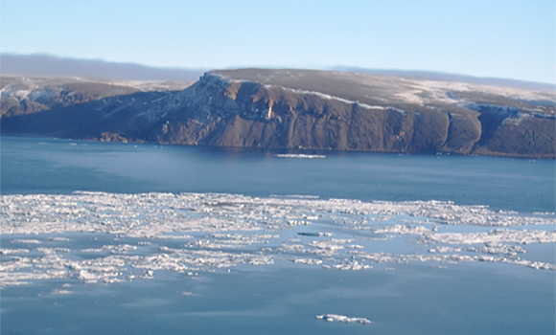
Establishing new Parks: Progress to date
Parks Canada continues to work with communities and indigenous peoples to protect natural environments representative of Canada's natural regions.
Newly established national parks - Nááts'ihch’oh (2014); Qausuittuq (2015); Mealy Mountains (2015); Thaidene Nene (2019).
The goal is to establish a system of national parks that represents each of Canada's distinct natural regions. In 2019, this system is now over 80% complete.

Slide 9
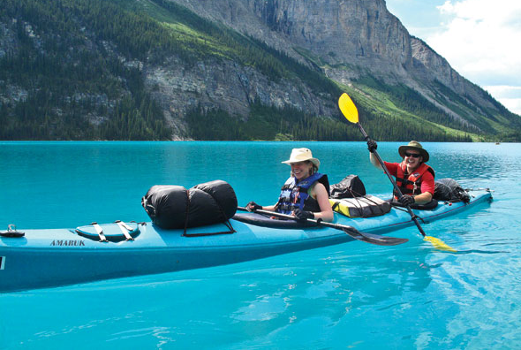
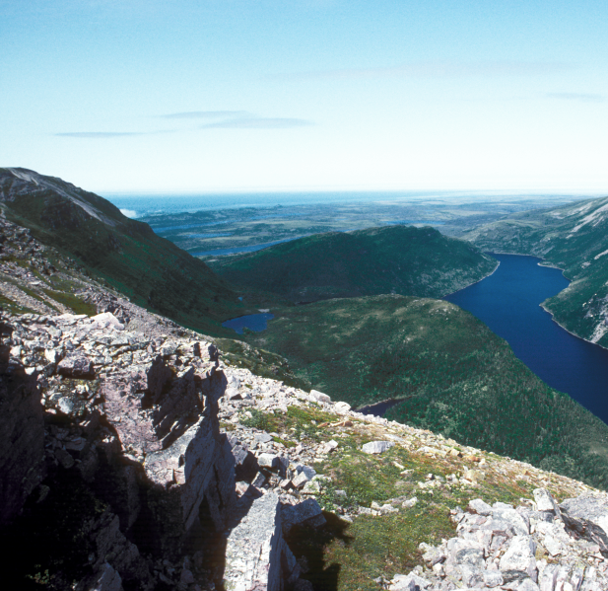
Linking National Parks to Broader Societal Priorities
Protecting the Canadian environment
Clean air and clean water
Protect wilderness and species at risk
Working collaboratively with Aboriginal peoples
Invest in local communities, jobs, tourism
Mitigate against the impact of climate change
Connecting Canadians to nature

Slide 10
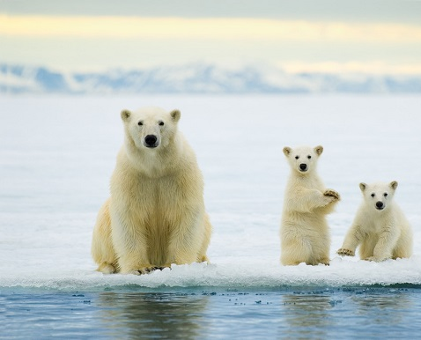
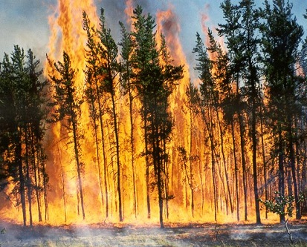
Managing Canada’s National Parks

Slide 12
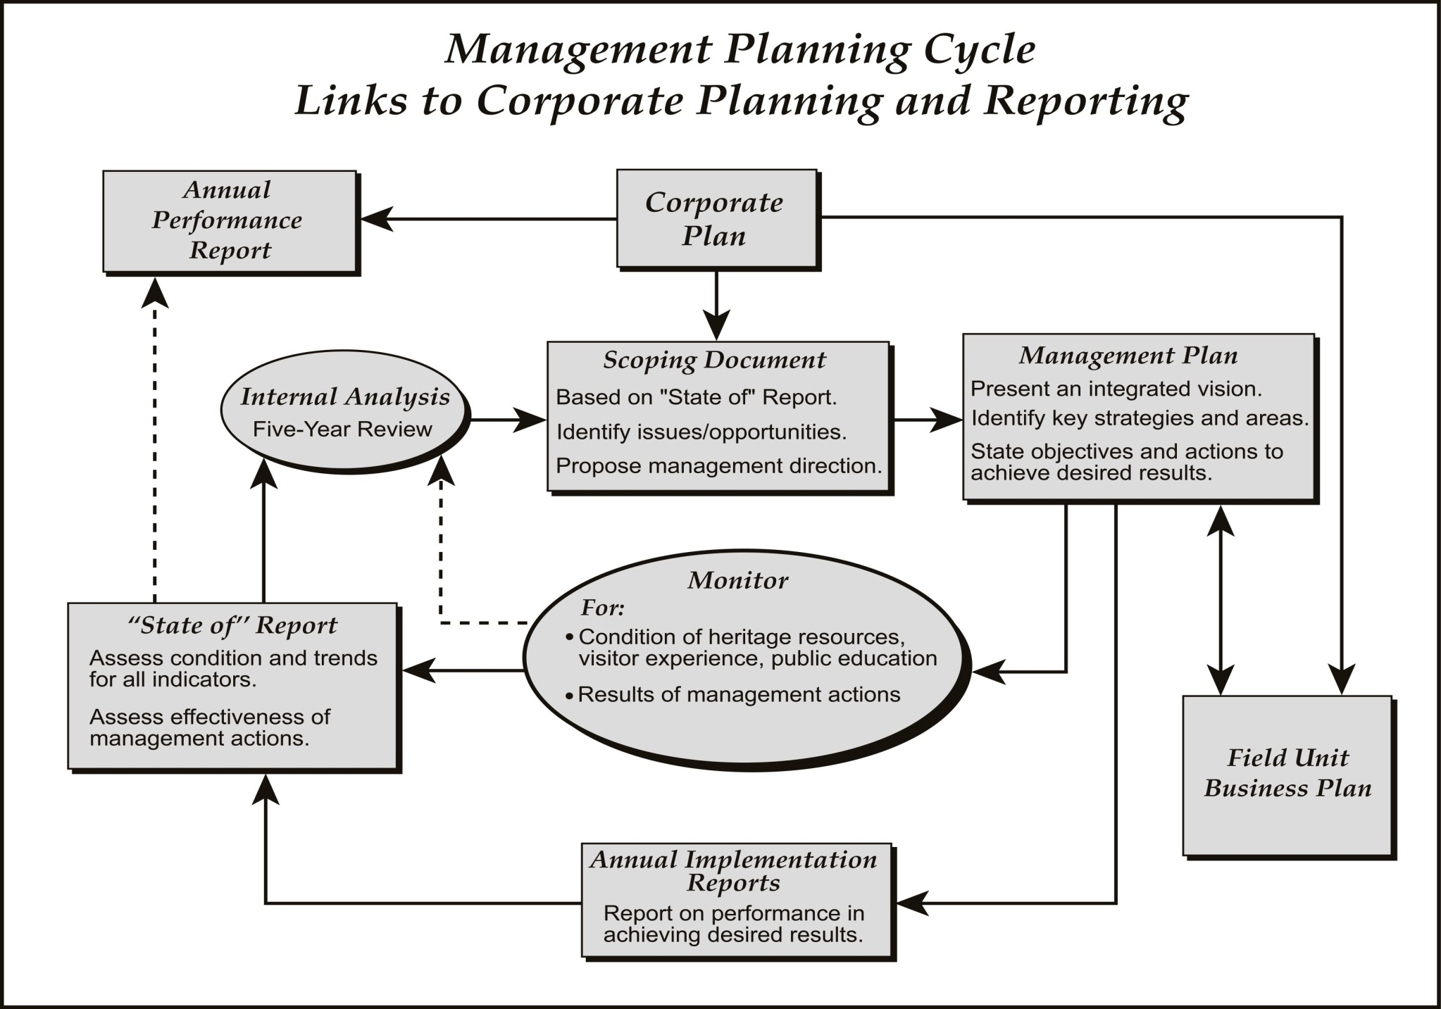
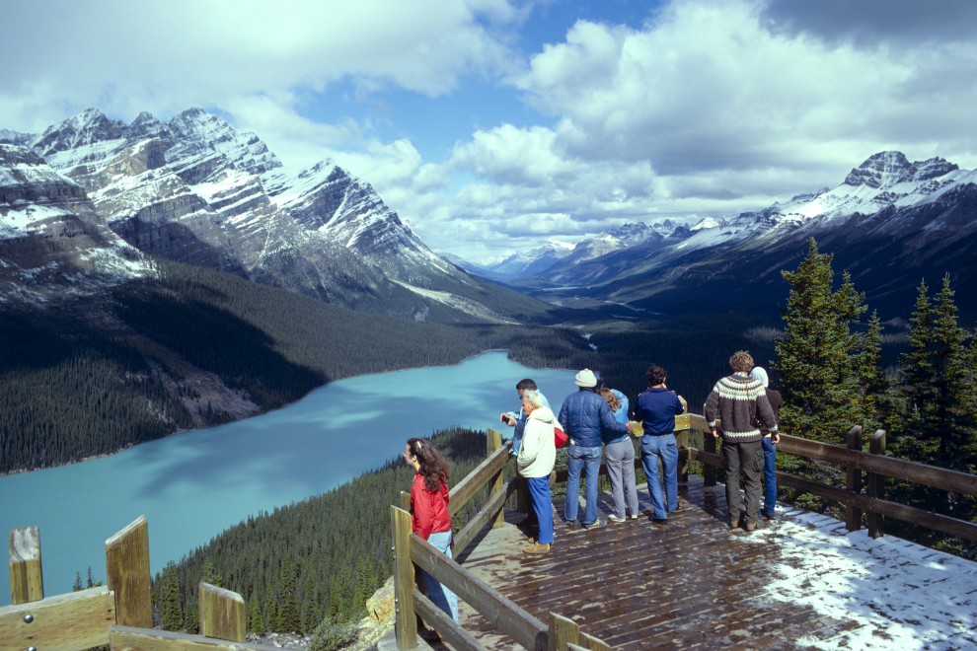
Management plan to be written within 5 years of the establishment of the national park
Management plans to be tabled by the Minister in Parliament
Must provide opportunities for consultation with Aboriginal communities and the public

Slide 13
Legal Definition: Ecological Integrity
"…a condition that is determined to be characteristic of its natural region and likely to persist, including abiotic components and the composition and abundance of native species and biological communities, rates of change and supporting processes.“
Management by Minister
(2) Maintenance or restoration of ecological integrity, through the protection of natural resources and natural processes, shall be the first priority of the Minister when considering all aspects of the management of parks.

Slide 14
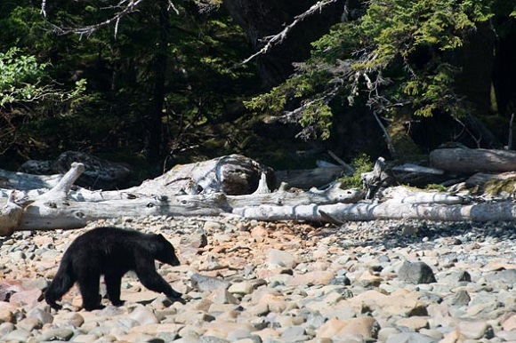
Ecological Integrity is the First Priority
Goal:
Management actions result in improvements in ecological integrity indicators of national parks
Expected Result:
Percentage of ecological integrity indicators in national park is maintained or improved.

Slide 15
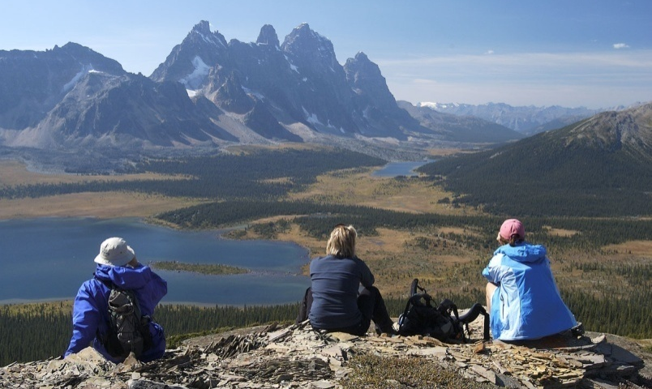
Public Appreciation and Understanding
Goal: Canadians appreciate the significance of national parks and support their protection
Expected result: Percentage of Canadians that support the protection of national parks administered by Parks Canada.
Expected result: Increase the reach of Parks Canada’s national parks through outreach and multimedia initiatives

Slide 16
ECOLOGICAL INTEGRITY MONITORING FRAMEWORK
Biodiversity
Processes and Functions
Stressors
Species Lists
native species
alien species
Focal Species
mortality/natility
immigration/emigration
viability/persistence
Species at risk
Trophic Structure
size class distribution
predation levels
Inside Park
most critical in-park stressors
Outside Park (with partners)
most critical stressors in greater park ecosystems
Outside Park (with partners)
most critical long distance stressors
Local Ecosystems
suite of measures that monitor most important structure and process changes at a local ecosystem scale
Landscapes
suite of measures that monitor most important structure and process changes at a landscape ecosystem scale

Slide 17
Ecological Integrity MONITORING FRAMEWORK: Indicators and Measures
Biodiversity
Process and Function
Stressors
Species richness
- change in species richness*
- numbers and extent of exotics*
Population Dynamics
- mortality/natility rates of indicator species*
- immigration/emigration of indicator species*
- population viability of indicator species*
Trophic structure
- size class distribution of all taxa
predation levels
Succession/retrogression
- disturbance frequencies and size
(fire, insects, flooding)*
- vegetation age class distributions*
Productivity
- Remote or by site
Decomposition
-by site
Nutrient retention
Ca, N by site
Human land-use patterns
- land use maps, roads densities, population densities.*
Habitat fragmentation
- patch size, inter-patch distance, forest interior*
Pollutants*
- sewage, petrochemicals etc.
- long-range transport of toxics
Climate*
- weather data, frequency of extreme events

Slide 18
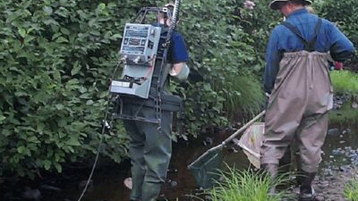
Importance of Ecological Monitoring
A monitoring program will provide a knowledge base:
to determine the state of ecological integrity
to help make management decisions
to focus priorities for management actions and investments
to assess the effectiveness of management actions and policies
To increase public understanding of changes in the park

Slide 20
Management actions (1): Prescribed fire to restore fire in the landscape and improve wildlife habitat

Slide 21
Management action (2): Removal of invasive species

Slide 22
Management action (3): Connecting wildlife habitat

Slide 23
Management action (4): Restoring ecosystem processes

Slide 24
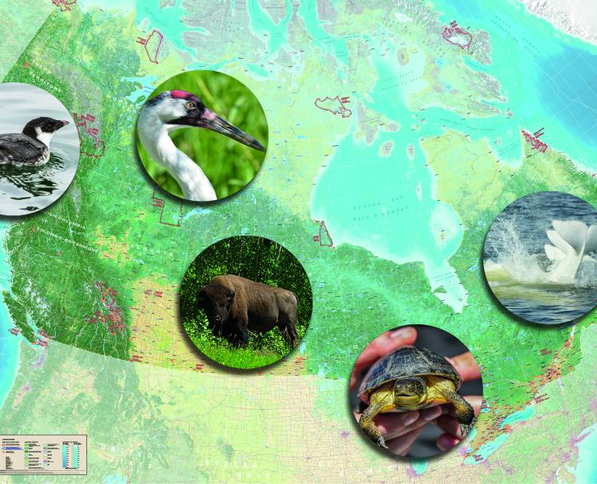
Management action (5): Re-introduction of native species

Slide 25
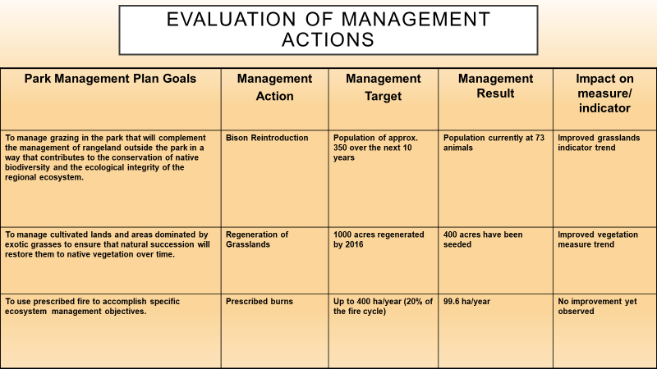

Slide 26
State of the Park Reports

Slide 27
Effective: Re-establishing and maintaining protected area values Efficient: Maximizing beneficial outcomes while minimizing while minimizing costs in time, resources, and effort Engaging: Collaborating with partners and stakeholders, promoting participation, and enhancing visitor experience
Best Practices for Ecological Restoration

Slide 28
Management plan to be written within 5 years of the establishment of the national park
Management plans to be tabled by the Minister in Parliament
Must provide opportunities for consultation with Aboriginal communities and the public

Slide 29
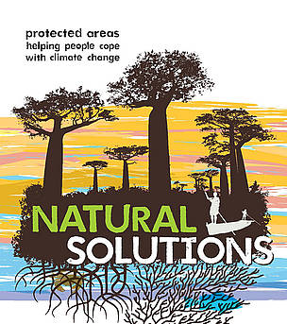
Protected Areas as natural solutions for climate change

Slide 30
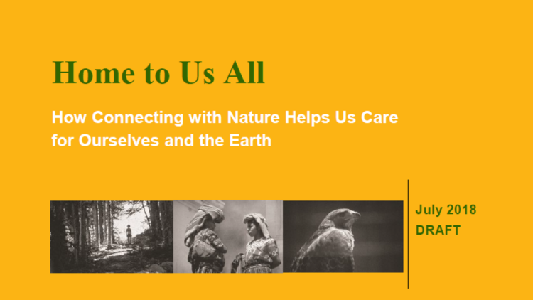
#NatureForAll Vision
Imagine a world in harmony and in love with nature…
In which all are aware of the values of a healthy planet. In which all can experience the earth’s natural wonders...
In which all are connected to thriving ecosystems, contributing to them and benefiting from all they have to offer...
In which all have conservation in their hearts and minds.
#NatureForAll Mission
Working together, we will help create a culture of conservation and a diversity of opportunities enabling new audiences and constituencies to fall in love with nature.

Slide 31
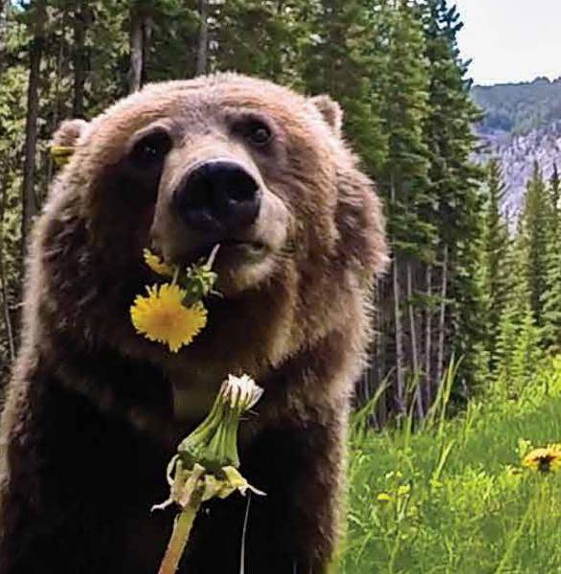
Thank you for your attention

