Slide 1
National Park Service
U.S. Department of the Interior
Pacific West Region
美国国家公园管理局西太平洋地区
Introduction to Park Planning
国家公园规划简介
NPS Mission:
The National Park Service preserves unimpaired the natural and cultural resources and values of the national park system for the enjoyment, education and inspiration of this and future generations. The service cooperates with partners to extend the benefits of natural and cultural resource conservation and outdoor recreation throughout this country and the world.
国家公园管理局的使命：
国家公园管理局保护公园内的自然和文化资源及其价值不受损害，愉悦、教育和启发当代及后代子孙。国家公园管理局与合作伙伴一起使自然和文化资源保护和户外休闲的惠益全美及全世界。

Slide 2
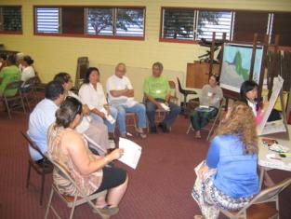
Why do we plan? 为何要进行规划？
Logical, trackable rationale for decision making:
使决策具逻辑性和可跟踪
law and policy
法律和政策
scientific, scholarly and technical information considering benefits, costs, and impacts (natural, cultural, socioeconomic)
科学、学术和技术信息，虑及益处、支出和影响（自然、文化和社会经济）
considering different perspectives and interests
兼顾不同观点和利益
Public involvement and understanding
公众参与和理解
Helps ensure:
有助于确保：
efficient use of public funds 有效使用公共资金
accountability 权责性
Required by law
法定要求

Slide 3
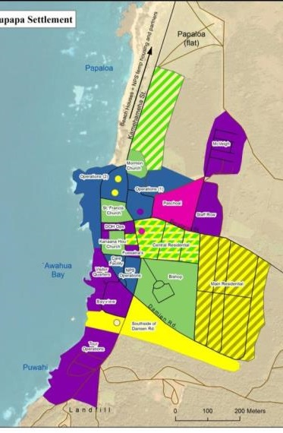
Legislative Direction 法定 (National Park System General Authorities Act, 54 USC 100502-100503) 国家公园管理局一般授权法案
General management plans for the preservation and use of each park shall be prepared and revised in a timely manner
各公园应编制保护和使用总体管理规划并及时更新
General management plans for each park shall include:
总体管理规划包括：
measures for the preservation of the area’s resources; 园内资源保护措施
indications of types and general intensities of development, 标明开发使用的类型和总体强度
visitor carrying capacities 游客承载力
potential boundary modifications. 潜在的边界调整
Each park shall prepare and make available to the public a 5-year strategic plan and an annual performance plan.
各公园应编制5年战略规划和年度绩效/工作计划，并面向公众开放

Slide 4
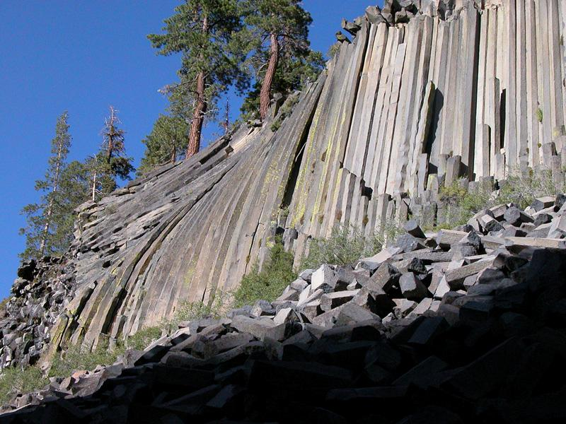
Planning program in transition 规划项目转型
Challenges 挑战
Limited funding
资金有限
Planning takes too long and costs too much
规划周期长，花费大
Derailed by controversy
因争议而受阻
Vision for a new planning program
新规划项目展望
Nimble 灵活性
Collaborative 合作
Flexible 适用性强
Sustainable 可持续性

Slide 5
Revised Framework for Park Planning 新修订的公园规划框架
Foundation
依据
Park purpose 公园的目的
Significance 重要性
Fundamental resources & values 主要资源与价值
Interpretive themes 解说主题
Assessment of planning needs 规划需求评估
Planning Portfolio 规划流程
Comprehensive
Plans
详细规划
Management
Plans
管理计划
Strategic
Plans
战略规划
Studies/
Inventories
研究/编目
Implement and monitor 实施与监测
5
Notes:
Cycle of planning –
Start with the foundation – what is this park about, what are the issues we’re facing, what do we need to plan for?
Do whatever planning the park most needs
Implement, monitor
Check back in with the foundation, and reassess planning needs for the new future

Slide 6
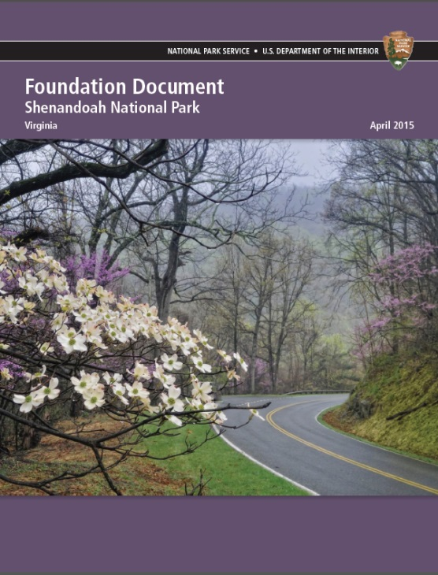
Foundation Documents 基础文件
NPS is preparing a foundation document for every park in time for NPS centennial
适值国家公园管理局百年庆典，国家公园管理局正在编制各个国家公园的基础文件
Provides underlying guidance for all management and planning decisions in a park
为各个国家公园的管理和规划决策提供基本指导
Prepared by a team that includes park managers, resource specialists, with leadership from the planning program
基础文件由规划项目牵头编制，编制团队成员还包括公园管理者和资源管理专家
Quick, intense process
（编制过程）快速且集中

Slide 7
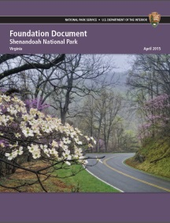
Foundation Documents 基础文件
Foundation Elements 基础文件组成要素
Description of the park 公园描述
Park purpose公园目的
Park significance
公园重要性
Fundamental resources and values
主要资源及价值
Interpretive themes 解说主题
Special mandates 特别规定
Key issues 主要问题
Assessment of planning and data needs 规划及数据需求评估
Park purpose is a statement of why Congress or the President established the park as a unit of the national park system. 公园的目的是陈述国会或者总统为何要将某地区纳入国家公园体系？

Slide 8
Foundation Documents 基础文件
Foundation Elements 基础文件组成要素
Description of the park 公园描述
Park purpose公园目的
Park significance
公园重要性
Fundamental resources and values
主要资源及价值
Interpretive themes 解说主题
Special mandates 特别规定
Key issues 主要问题
Assessment of planning and data needs 规划及数据需求评估
Significance statements express why the park’s resources and values are important enough to be part of the NPS.
重要性陈述说明为何园内资源及其价值重要至要将其纳入国家公园体系内

Slide 9
Foundation Documents 基础文件
Foundation Elements 基础文件组成要素
Description of the park 公园描述
Park purpose公园目的
Park significance
公园重要性
Fundamental resources and values
主要资源及价值
Interpretive themes 解说主题
Special mandates 特别规定
Key issues 主要问题
Assessment of planning and data needs 规划及数据需求评估
Interpretive themes are the most important ideas or concepts to be communicated to the public about a park.
解说主题是某一公园向公众传达的最重要的想法或概念

Slide 10
Foundation Documents 基础文件
Foundation Elements 基础文件组成要素
Description of the park 公园描述
Park purpose公园目的
Park significance
公园重要性
Fundamental resources and values
主要资源及价值
Interpretive themes 解说主题
Special mandates 特别规定
Key issues 主要问题
Assessment of planning and data needs 规划及数据需求评估
Planning needs: what are the most important plans that are needed to resolve park issues, protect park resources, and provide for visitor enjoyment?
规划需求：解决公园的问题，保护园内资源和供游客娱乐需要哪些重要的规划？

Slide 11
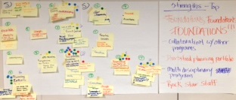
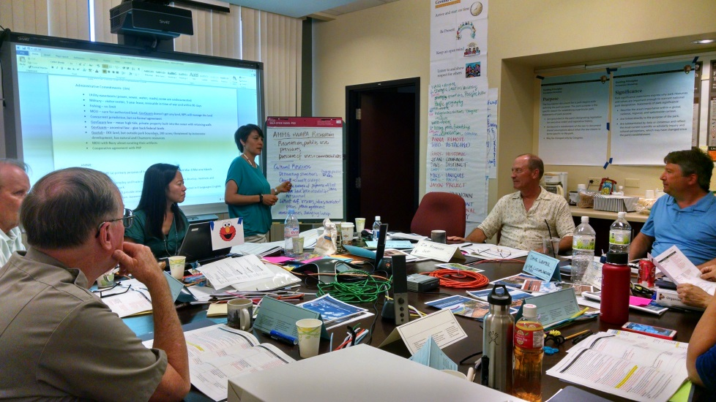
Planning Priorities? 规划优先序
What kinds of planning are most parks doing?
大多数公园编制哪些规划？
Strategic Planning 战略规划
What is most important for us to be doing with limited funding and staff?
在资金和人员有限的情况下，哪些是最为重要需要我们做的？
Where do we want to be in 3-5 years? 3-5年之后，我们的发展定位是什么？
What do we need to do to get there? 实现发展定位，需要做些什么？

Slide 12
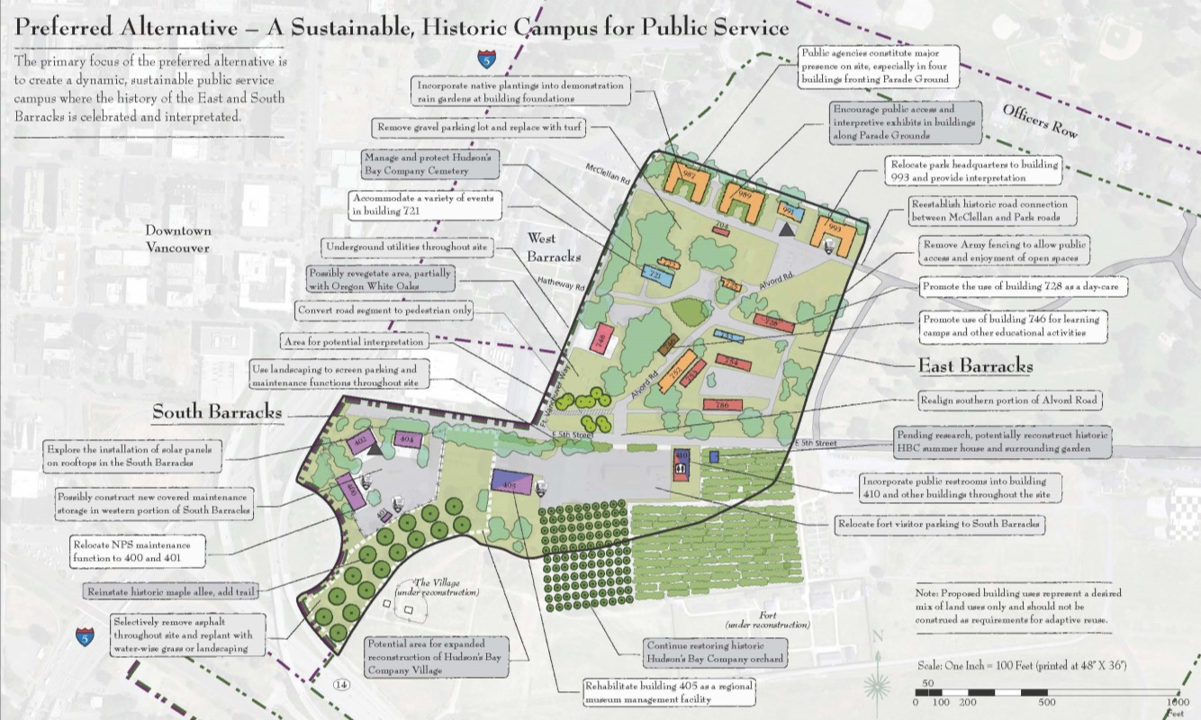
Planning Priorities? 规划优先序
What kinds of planning are most parks doing?
大多数公园编制哪些规划？
Site Planning 场地规划
Planning for specific areas to address issues such as access, transportation, congestion, safety, visitor experience, resource protection
为特定地区编制规划，解决包括通达性、交通堵塞、安全性、游客体验和资源保护等问题

Slide 13
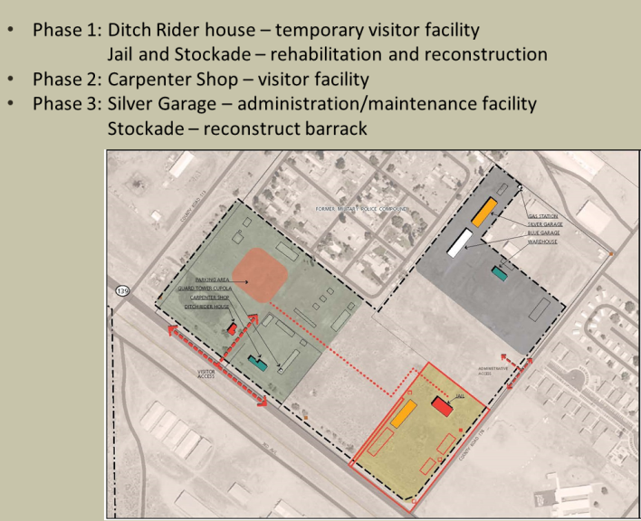
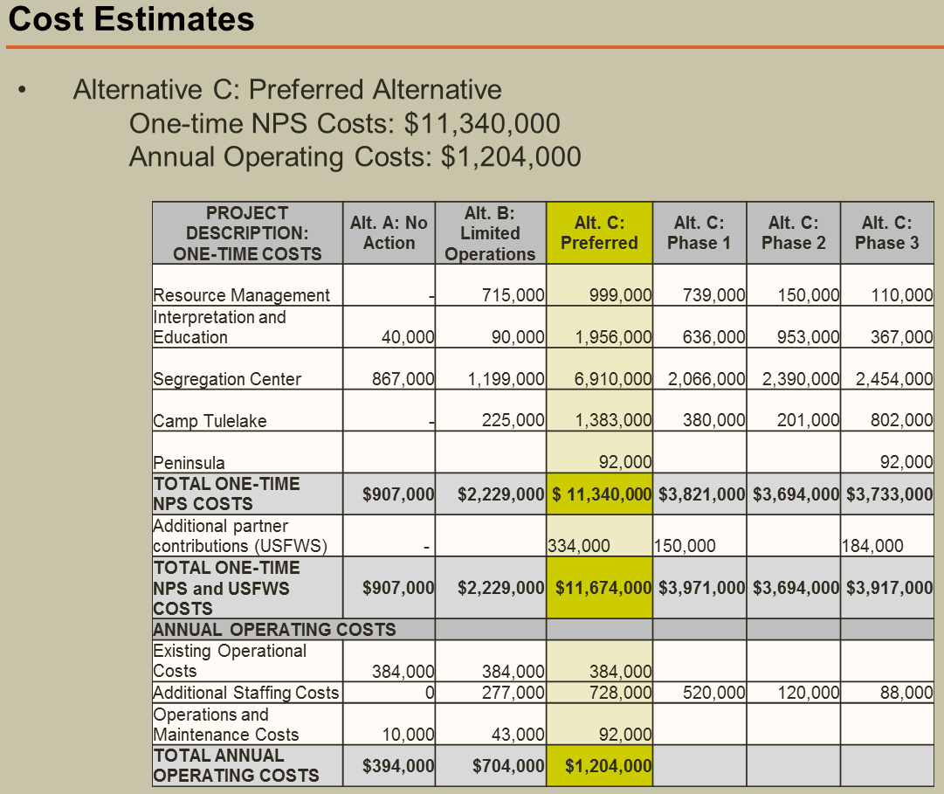
Planning Priorities? 规划优先序
What kinds of planning are most parks doing?大多数公园编制哪些规划？
General Management Planning (new parks only) 总体管理规划（仅限于新建公园）
Sets long term goals for the parks 为公园设定长期目标
Provides broad direction for resource preservation and visitor use 确定资源保护和游客使用的大方向
Identifies types of management activities, development and visitor use that are needed 确定管理活动、需要的开发和游客使用的类型

Slide 14
Planning Priorities? 规划优先序
What kinds of planning are most parks doing?
大多数公园编制哪些规划？
Visitor Use Management Planning 游客使用管理计划
Manage visitor demand, reduce conflicts 管理游客需求，减少冲突
Resource Stewardship Strategies 资源管理战略
Strategy for achieving desired resource conditions 达到预期资源（管理或保护）状态应采取的战略措施
Interpretive Planning 解说计划
Recommends services, media and activities to best communicate to the visitor 提议可增进与游客有效交流的服务、媒介和活动
Business Planning 商业计划
Improve financial planning and determine operational goals 改善资金规划，确定运营目标

Slide 15
Hot Topics! 热门话题
Costs 费用
Need to do more robust cost estimating in all our planning
在规划中应对费用进行更可靠的估算
One time capital costs 一次性建设费用
Annual operating costs 年度运营支出费用
Total cost of facility ownership (TCFO) 设施所有权总支出

Slide 16
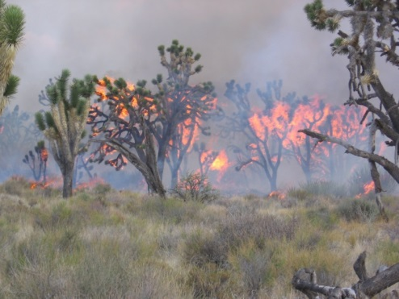
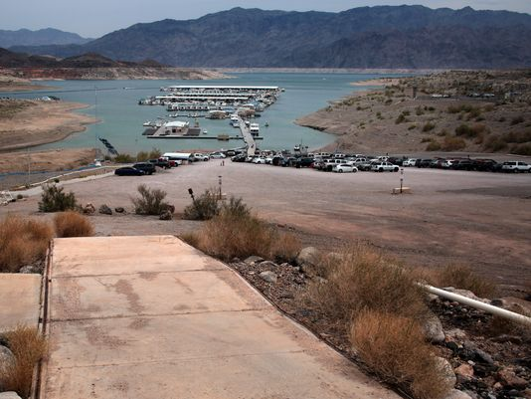
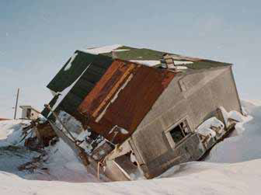
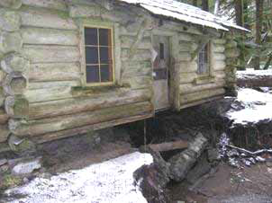
Hot Topics! 热门话题
Climate change 气候变化
Is already impacting NPS resources
正影响着国家公园内的资源
Need to address in all our planning
规划中需阐明如何应对气候变化
Integrate with existing planning processes
纳入现有的规划过程
Describe what is different about planning in the context of climate change
描述气候变化对规划的影响

Slide 17
Hot Topics! 热门话题
Accessibility
通达性
Facility and program accessibility – required by law
设施和项目的无障碍通道-法律规定
Self assessment and transition planning for all parks
所有公园都在进行自我评估和过渡计划
Identify key park experiences and park areas
找出关键的公园体验和公园区域
For example: trails, restroom, signs, exhibits, campgrounds
例如：小道、厕所、标识、展览和露营地
Recommend accessibility improvements - identify barriers and solutions
提出提高无障碍性的建议 – 障碍和解决方法
For example, add ramps, improve slope, change door handles, provide tactile (touchable) exhibits
例如：增加增加坡道，改善坡度，改变门把手，提供触觉（可触摸）展品

Slide 18
Hot Topics! 热门话题
Visitor Capacity 游客容量
With record-high visitation, parks find it more critical to manage visitation
随着访问量达到创纪录水平，发现公园访客管理更加重要
Evaluate impacts of visitor use
评估游客使用的影响
Manage amounts and types of visitation – determine when visitors are causing unacceptable impacts, and make changes in management to reduce the impacts – before unacceptable impacts occur
管理访客数量和类型，明确在什么情况下游客会对公园带来不可接受的影响。在发生不可接受的影响前， 改善管理去减少带来的影响。

Slide 19
Hot Topics! 热门话题
Civic Engagement
公众参与
NPS is committed to:
国家公园管理局致力于：
Welcoming the public to enjoy the parks
欢迎公众享受公园
Listening and responding to diverse public viewpoints, values, concerns
倾听和回应不同的公众意见、价值观和顾虑
Collaborating with partners
和合作伙伴合作
Sharing information about the parks
分享公园的信息
Involving the public in decisions
公众参与决策
Connecting with and creating the next generation of park visitors, supporters and advocates
培养、与下一代公园的游客、支持者和倡导者建立联系

Slide 20
National Park Service
U.S. Department of the Interior
Pacific West Region
美国国家公园管理局西太平洋地区
Questions?
问题

