Slide 1
Briefing for Leaders of the
China National Park Administration
September 9, 2019
简报会 – 报告给中国国家公园管理局领导人
2019年9月9日
Notes:
Great to be here and meet all of you. As you know, I work for the National Parks Conservation Association. I have served as the Regional Director of the organization for 14 years. My region includes California, Nevada, Hawaii, American Samoa and other Pacific Islands. I’ll talk more about NPCA in a moment.

Slide 2

Kumbum Monastery, Qinghai
Notes:
In April of 2018, my wife and I took our first trip to China. We had a great time. We visited many Buddhist Temples including Kumbum Monestery in Qinghai and some national parks, including Heavenly Lake.

Slide 3
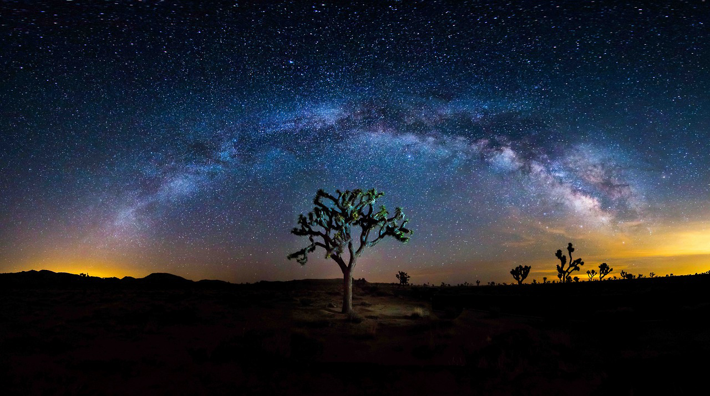
What is the National Parks Conservation Association?
Non-Profit Parks Advocacy Organization
什么是国家公园保护协会？
非盈利性公园倡导组织
Notes:
1. We are a non-profit National Parks Advocacy Organization, and I will explain that in more detail in few minutes.
2. We not affiliated with the government.
3. We do not get money from the government.
4. We often have a different view on matters related to national parks than the government.
5. We have 1.3 million members and activists and our headquarters is in Washington, DC.

Slide 4
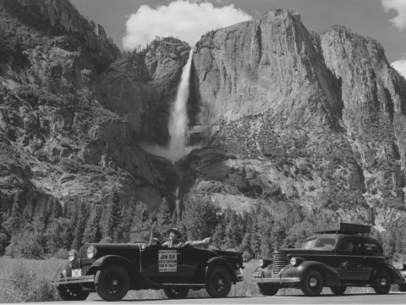
NPCA Started in 1919
国家公园保护协会始于1919年
国家公园管理局成立三年后
需要一个保护者
非政府机构
3 Years after NPS
Needed a Protector
Not part of Government
Notes:
NPCA started 3 years after the NPS. Why? Because it needed a protector that was independent. The government could not protect and support the park alone.
In 1916 the first Director of the NPS was Stephen Mather. (NEXT SLIDE)

Slide 5
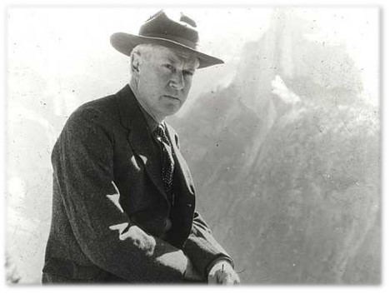
First Director of the NPS
He realized that the Parks Needed an outside voice
NPCA的第一个捐赠者：斯蒂芬·马瑟
NPS的第一任局长，他意识到公园需要一个外部的声音
NPCA’s First Donor:
Stephen Mather
Notes:
- As the Director of the NPS for three years, Director Mather realized that there needed to be an outside voice. He used some of his own funds to seed the start-up of what was then called the National Parks Association.

Slide 6
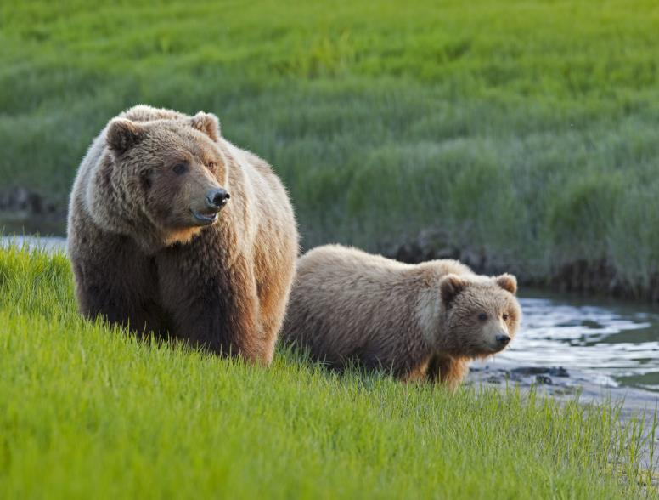
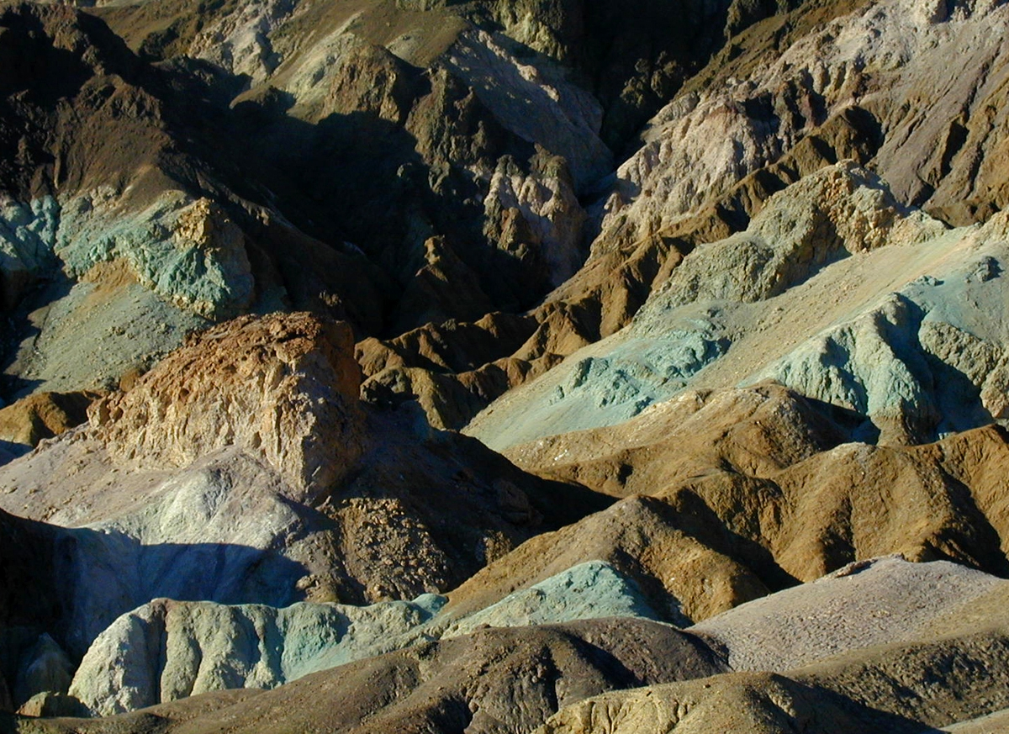
We grew a lot after 1919
27 offices 160 staff
Celebrating 100 years
What we Do:
1. Protect our Parks from Threats
2. Advocate for New Parks & Expansions
3. Advocate for Park Funding
1919至今我们的队伍壮大了许多
27个办公室，160名员工
庆祝100周年
工作内容：1.保护我们的公园 2.倡导新公园建设和扩建 3. 倡导更多公园资金
Notes:
So NPCA was born in 1919 – and we are now celebrating our 100th Anniversary.
We grew over those 100 years. NPCA now has 27 offices throughout the United States, with about 160 staff.
But what does NPCA that has made it so vital?
NPCA protects the parks from threats – and there are many threats.
We work to help the NPS create new national parks, including historic parks -- and we often advocate for expansion of parks.
We work to make sure that the President and Congress support robust funding for the national parks

Slide 7
NPCA Revenue
NPCA资金收入
Notes:
NPCA, as I mentioned, does not take funds from the government. We work closely with the NPS, but we are not funded by them or any other government entity.
Where does our support come from?
As you can see on this chart, the largest amount is coming from contributions from our members and supporters. We also get significant support through grants from foundations. We also receive support from some companies that want to be associated with us, including companies such as Nature Valley Granola Bars and Subaru vehicles.

Slide 8

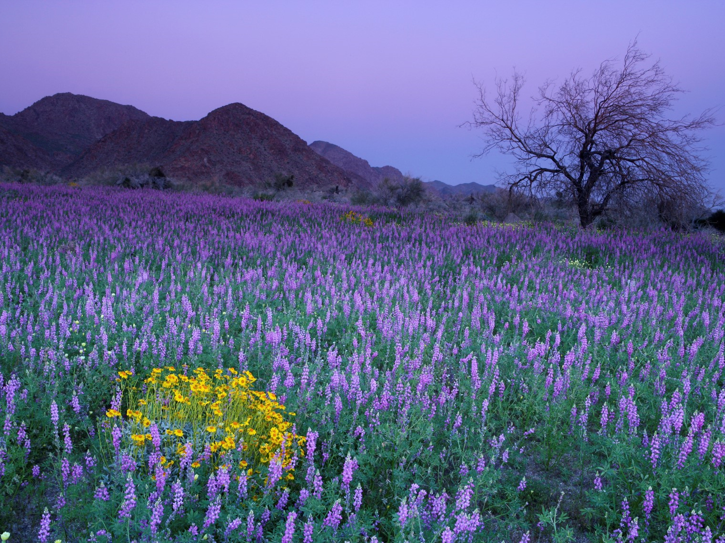
How Does NPCA Do Its Work?
NPCA是如何工作的？
Gathers Information and Establishes Expertise
Develops Political Support
Uses that Power to Lobby Congress and Administration
Cooperates with NPS
Works on Passing Legislation
Uses Court System When Needed
Works with Media to Get Word Out (Newspapers/television/social media)
-收集信息并储备专业知识
-发展政治支持
-利用这一能力游说国会和行政部门
-与NPS合作
-致力于促进立法进程
-在需要时，法院系统
-与媒体合作发布消息(报纸/电视/社交媒体)

Slide 9
What we Do:
1. Protect our Parks from Threats
我们的工作：1. 保护我们的公园免受威胁
Notes:
NPCA protects the parks from many threats. I am now going to talk about some of the campaigns that we have worked on.

Slide 10
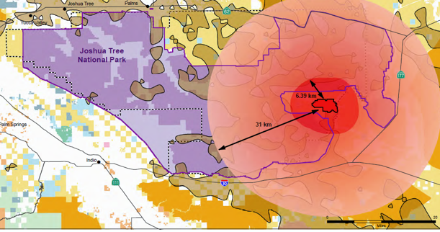
Park Threats – Eagle Mountain Landfill at Joshua Tree National Park
对公园的威胁-约书亚树国家公园的鹰山垃圾填埋场
Notes:
This was a successful campaign to stop a landfill from being built right next to Joshua Tree National Park. As you can see, the landfill, had it been built, would have been surrounded on three sides by the park.

Slide 11
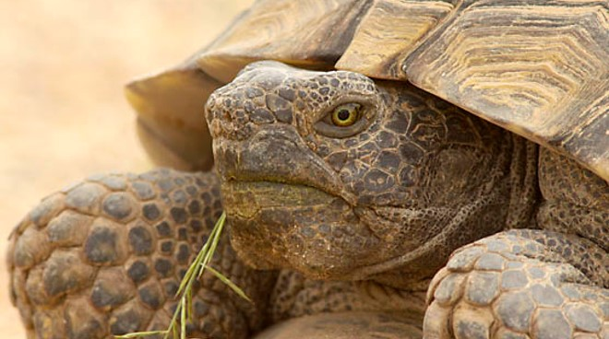
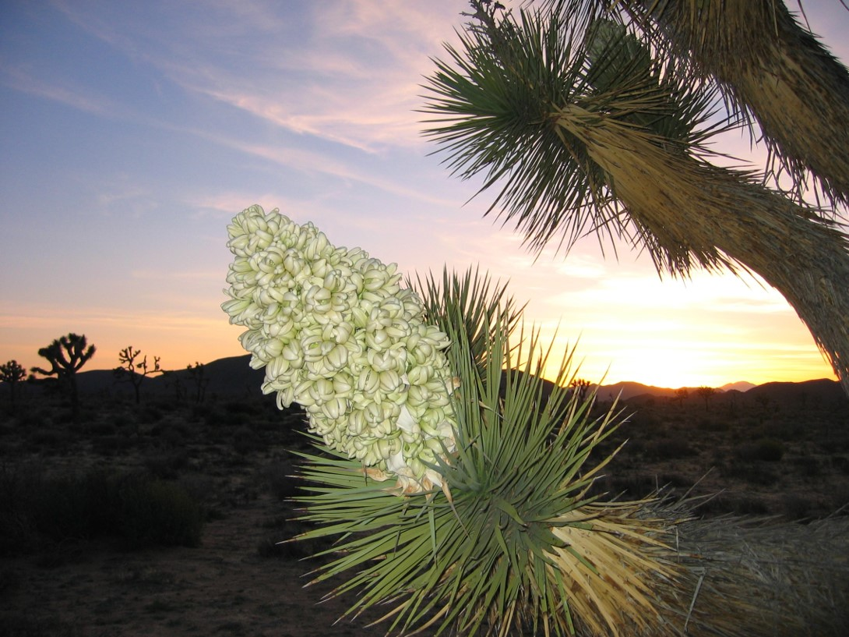
- LA Trash
- Largest Landfill
- Desert Tortoises Threatened
- 20,000 tons a day
- Last a century
-洛杉矶垃圾
-最大的垃圾填埋场
-沙漠龟受到威胁
-每天20，000吨
-持续一个世纪
Victory after 15-year Battle
- Federal Court Ruled for NPCA in 2009
- 15年战斗后的胜利
-2009年联邦法院裁定NPCA胜诉
Notes:
1. The proposed Eagle Mountain Landfill was going to be for trash coming from LA.
2. It would have been the LARGEST landfill in the country and probably in the world
3. It was a big threat to Desert Tortoises, a threatened species
4. The landfill would have taken in 20,000 tons of garbage a day
5. It would have lasted an entire century
WE WAGED a 15 YEAR BATTLE and WON!
The Federal Court system ruled in our favor in 2009 and that stopped the landfill from being built.

Slide 12
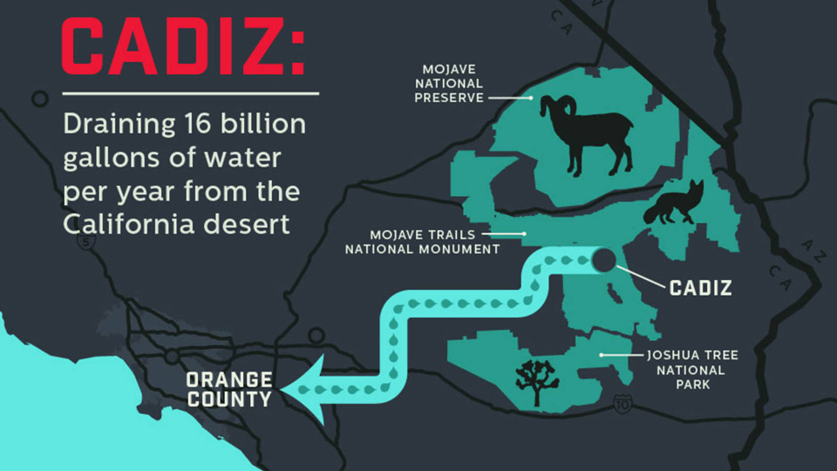
CADIZ水矿项目
Cadiz Water Mining Project
Notes:
CADIZ Water Mining Project
This is a current campaign. The Cadiz Corporation has proposed withdrawing groundwater out from under the Mojave National Monument
-16 billion gallons of water a year would be pumped out, which is not sustainable.
- It would result in many water features in the Mojave drying up and would negatively effect the plants and wildlife in the Mojave
- The Obama Administration stopped the project, but when Trump came in that decision was reversed.
WE JUST WON A BIG three-yearlong effort to get California to tighten its laws that will likely stop this project from going forward and we are also suing the Department of Interior to reverse their approval decision.

Slide 13
What we Do:
2. Advocate for New Parks & Expansions
工作内容：2.倡导新公园建设和扩建
Notes:
2. We work to help the NPS create new national parks, including historic parks -- and we often advocate for expansion of parks.

Slide 14
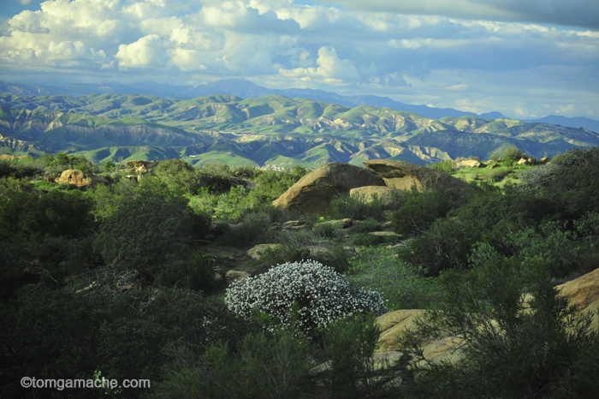
Expansion of Santa Monica Mountains National Recreation Area
圣莫尼卡山脉国家休闲区扩建
Notes:
Santa Monica Mountains National Recreation Area is near LA, with some sections that are in the city.
One of its key benefits is the protection of habitat for wildlife in an area that is quickly being developed
It is also a great recreations resource for millions of people in the LA region
About 15 years ago we became involved in efforts to expand the park.

Slide 15
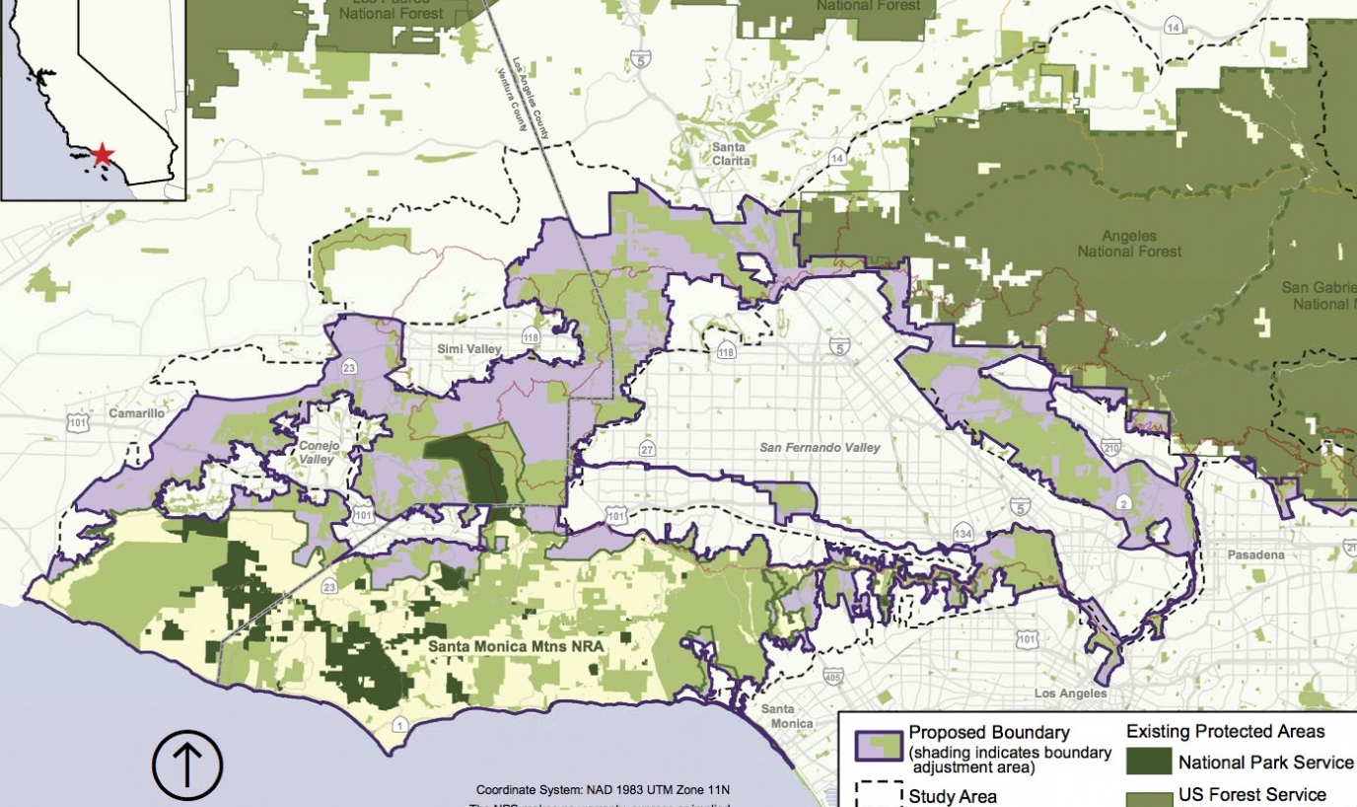
向山谷边缘的扩张使圣莫尼卡山脉国家休闲区面积增加一倍以上
Rim of the Valley Expansion Will More Than Double Santa Monica Mountains NRA
Notes:
Currently this park is about 155,000 acres
We, members of Congress and the NPS are in support of more than doubling the size of the park
It would include sizable sections of the LA River and even downtown LA, where many excellent cultural sites are present, such as the oldest residence in LA, The Avila Adobe.
We have made great progress on this effort and we think that the park will be expanded sometime within the next couple of years.

Slide 16
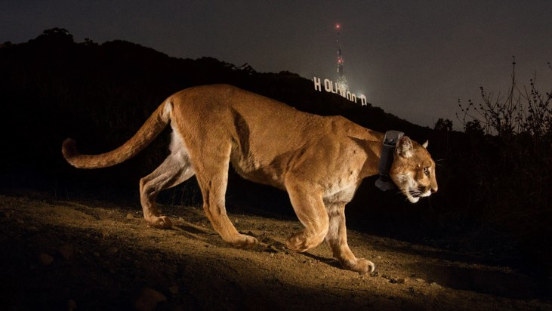
扩张将造福美洲狮
Expansion Will Benefit Mountain Lions
P-22 in LA’s Griffith Park
Notes:
One of the critters that will benefit greatly from the expansion of Santa Monica Mountains NRA is the Mountain Lion. Here is the famous P-22 in LA’s Griffith Park, but P-22 is isolated because of fragmentation of the habitat. The other problem is that the gene pool for mountain lions in the region is being compromised, potentially leading to the loss of the species from the region.

Slide 17
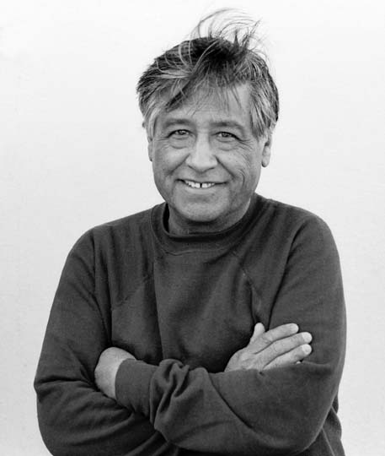
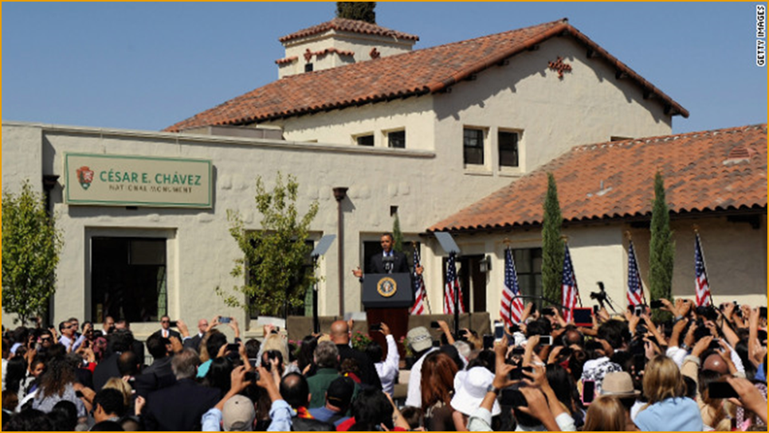
为塞萨尔·查韦斯纪念碑开展的活动
Campaign for Cesar E. Chavez Monument
NPCA Campaign 1999-2012
Rep. Hilda Solis Sponsors Bill and Consolidated Natural Resources Act of 2008 passed
Special Resource Study
President Obama Uses Antiquities Act to Establish the César E. Chávez National Monument
Cesar E. Chavez
Photo Cred: Victor Aleman
-NPCA组织的活动1999-2012
-代表希尔达索利斯赞助法案，2008年自然资源综合法案获得通过
-特殊资源研究
-奥巴马总统根据“古迹保存法案”建立了塞萨尔·查韦斯国家纪念碑
President Obama - October 8th, 2012
Notes:
The Cesar E. Chavez National Monument. This is a monument that interprets the life and times of labor leader Cesar Chavez and it tells the story of how farmworker laborers were successful in forming a union and winning better conditions for workers.
Campaign lasted from 1999 through 2012
We supported legislation introduced by Rep. Hilda Solis to study the possible creation of a new NPS site that would cover Cesar Chavez’s life and the union movement, which passed in a consolidated bill in 2008
Because of the positive findings of the study, key elected officials, including President Obama, supported the establishment of the park.
On October 8th, 2012 (just a month before his re-election) Obama used the Antiquities Act to create the park in the Tehachapi Mountains in California.

Slide 18
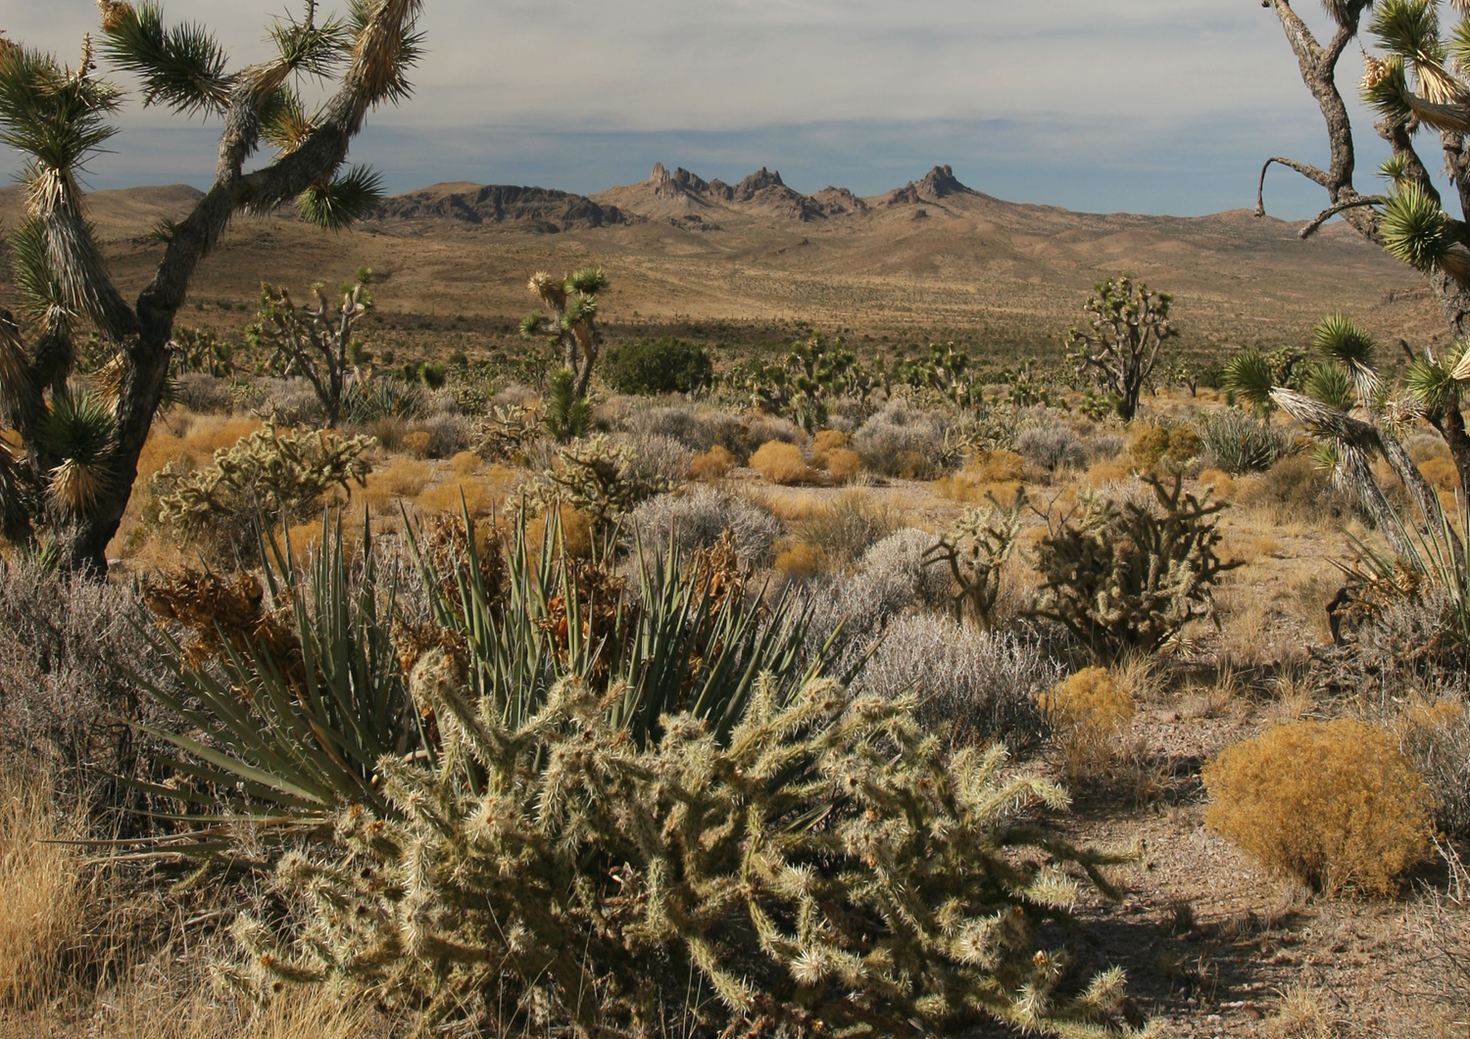

Notes:
Another campaign to establish a new park was also completed during the Obama Administration – Castle Mountains National Monument in Eastern CA on the Nevada border.
It is close to 21,000 acres in size and is surrounded on three sides by the Mojave National Preserve. The area was not included in the Preserve because of a mining operation that is there.
The action by Obama, with our strong support, gave the Castle Mountain Area the protection it needed.
It protects a wonderful Joshua Tree forest and numerous rare plants and wildlife.

Slide 19
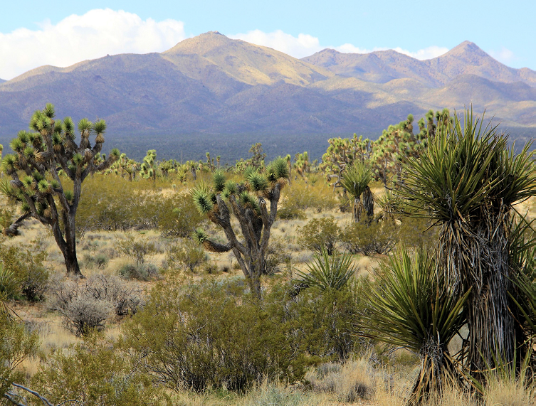
Crescent Peak Region
Notes:
The Crescent Peak Region is in Nevada, just over the border from Castle Mountains National Monument.
We hope to also protect this area by creating a new monument. The area is threatened by development. In fact we just stopped a renewable energy project from being built in the area.
We are working closely with tribes in the region, because this area is very near Spirit Mountain, which you can see in this photo. It is a sacred place for the tribes in the area.

Slide 20
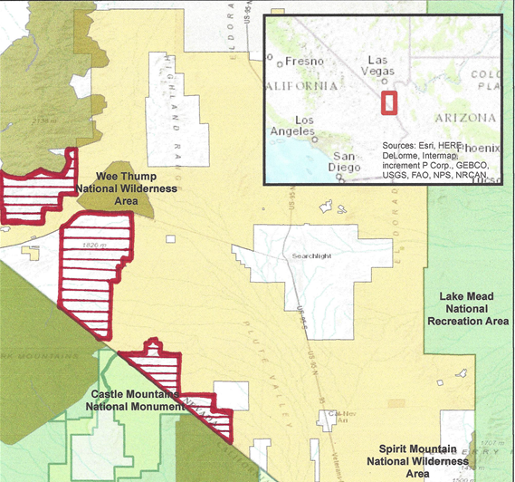

Crescent Peak Region Map
Notes:
Here is a map of the area. As you can see, Castle Mountains National Monument is there on the border and the area to the east of it was proposed for development. The new monument would protect the area from Castle Mountains to Lake Mead, establishing a protected wildlife corridor and protect the Spirit Mountain viewshed.

Slide 21
What we Do:
3. Advocate for Park Funding
工作内容：3. 倡导更多公园资金
Notes:
3. We work to make sure that the President and Congress support robust funding for the national parks

Slide 22
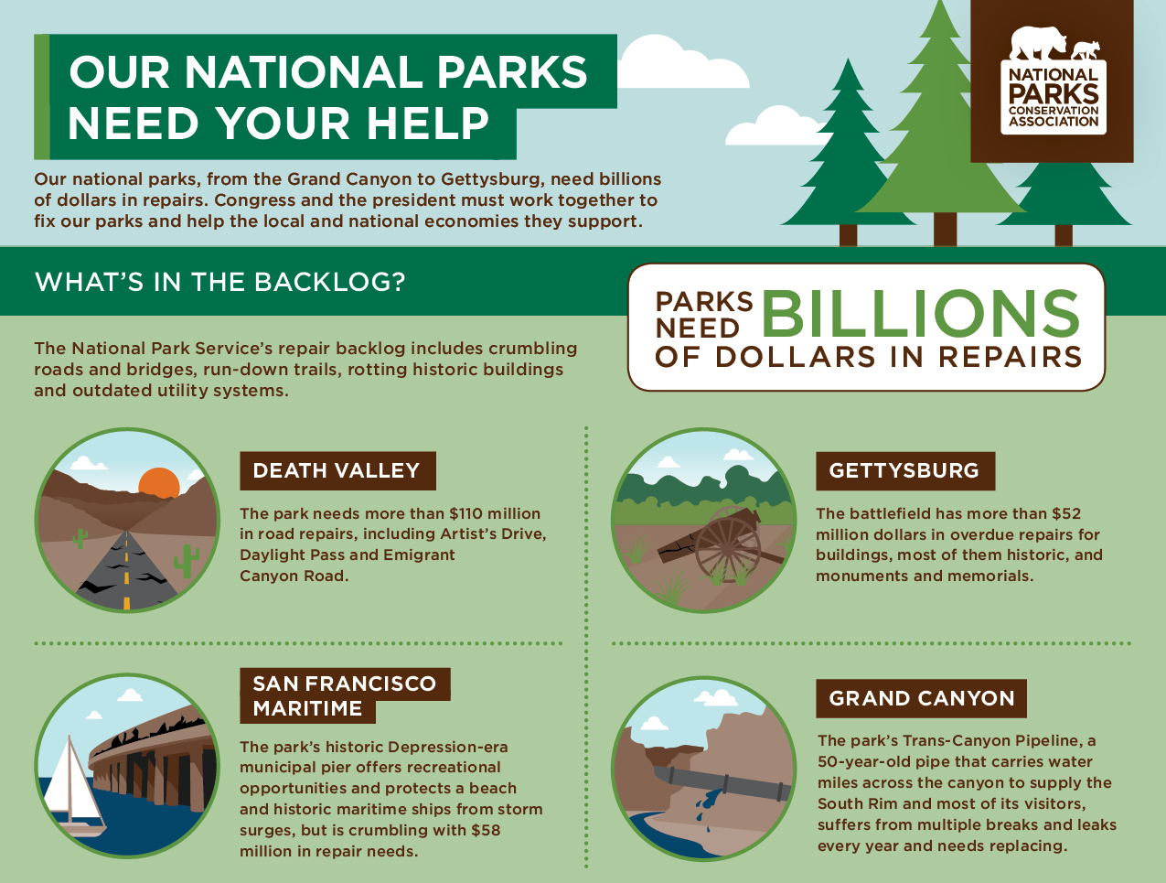
公园资金--110亿美元积压待办的事务
Park Funding - $11 Billion Backlog
Notes:
One of the biggest problems with the parks is the deferred maintenance backlog. It stands at about $11 billion.
We have a campaign to pass legislation to significantly decrease this backlog over time.

Slide 23
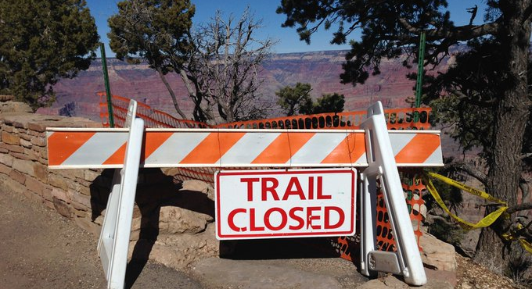
修复我们的公园法案活动
Restore our Parks Act Campaign
- Up to $1.3 billion a year
- 2019 - 2023
-每年最高达13亿美元
-2019年至2023年
Notes:
NPCA is leading the Restore Our Parks campaign to pass legislation that would provide $1.3 billion a year for five years.
NPCA also fights each year to get a strong annual allocation for the NPS budget, which pays for operations and personnel costs.

Slide 24
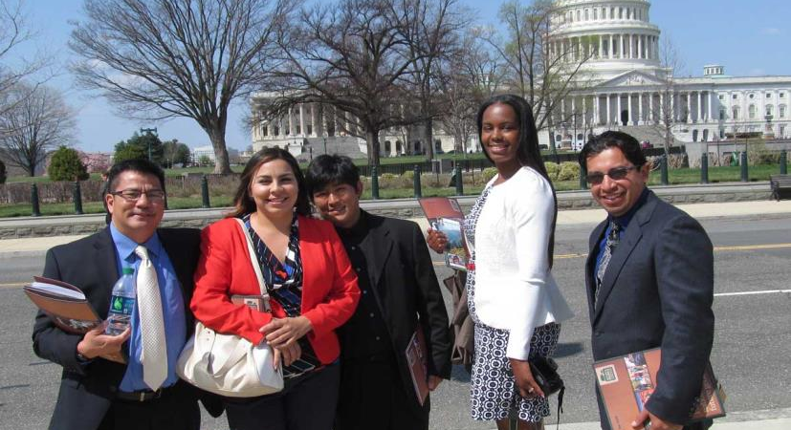
招募下一代
Recruiting the Next Generation
加州年轻人在华盛顿特区学习游说
Young Californian’s Learning to Lobby in Washington, DC
Notes:
Before ending with a video, I want to talk a little bit about our efforts to make our movement more diverse.
Historically the conservation and environmental movements have been mostly dominated by white men, which means that a very large portion of our population was not involved.
We are now changing that by outreach to people of color, especially in places like California, where most of the population is non-white.
We are working hard to reach put to new constituencies, and this is one group of young people who travelled from CA to DC to help us lobby on Capitol Hill for park funding.

Slide 25
Video – Santa Monica
Notes:
And now I want to share this video with you that highlights some of that community-based outreach that we are doing in Los Angeles near the Santa Monica Mountains National Recreation Area. I hope you enjoy it.

