Slide 1

Clean Air & National Parks
Cle
清洁的空气与国家公园
Carol McCoy,
Chief, Air Resources Division, NPS
_________________________
September 11, 2019
Berkeley – University of California
Institute for Parks, people, and Biodiversity
卡罗尔·麦考伊，NPS空气资源部主任

Slide 2
Topics
Air Quality Basics
    Sources of Air Pollution
    Impacts on Parks
Mandates
    Clean Air Responsibilities
    Clean Air Actions
Air Quality in Parks
    Air Clarity, Ozone, Nitrogen & Sulfur Deposition, Mercury
Partnership Opportunities
Brief Overview on Water Resources & Parks
空气质量基础认识
空气污染源
对公园的影响
强制执行
空气清洁的责任
空气清洁的行动
公园内的空气质量
空气清晰度、臭氧、氮和硫的沉积、汞
合作机会
水资源与公园的简要概述

Slide 3
PREFACE
前言
National Parks Are Special Places
国家公园是特殊的地方
Notes:
National parks in the US and in China preserve a wide variety of amazing natural and cultural resources.

Slide 4
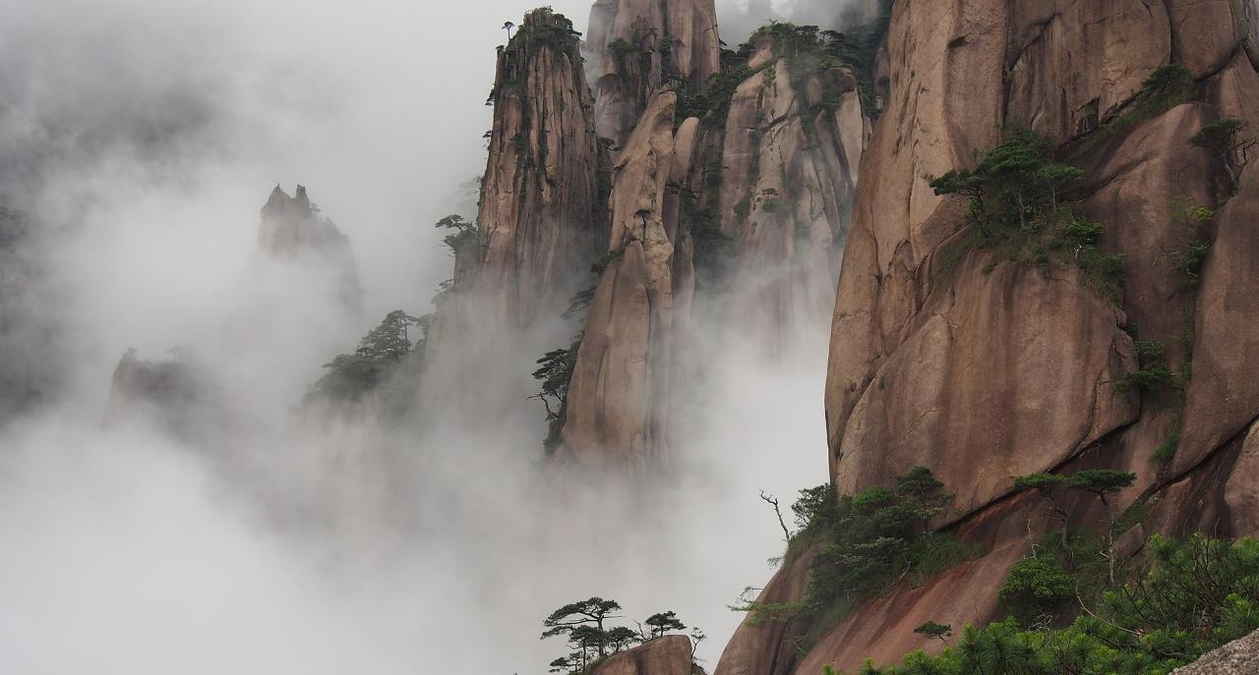
Mount Sanqing - Jiangxi, China
中国江西三清山
Notes:
Some of our two countries’ parks and protected areas are quite unique, while others share remarkable similarities.
----------------------
Photo of panoramic view from Mount Tianzi Shan, Wulingyuan Zhangjiajie hunan China tujia miao 2012
https://en.wikipedia.org/wiki/Zhangjiajie#/media/File:1_tianzishan_wulingyuan_zhangjiajie_2012.jpg

Slide 5
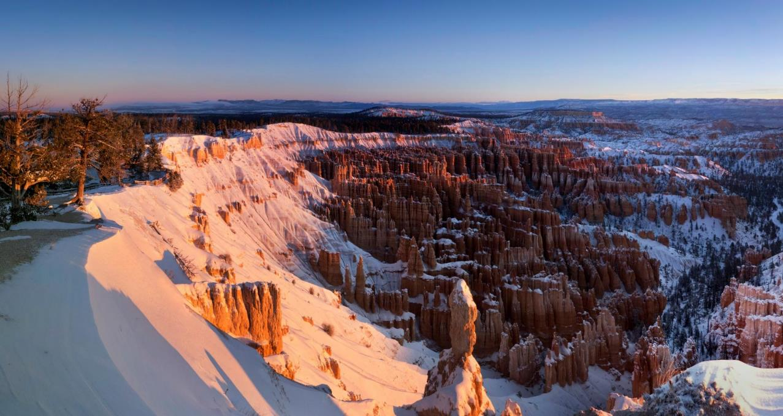
Bryce Canyon National Park – Utah, USA
美国犹他州布莱斯峡谷国家公园
Notes:
----
Photo of Bryce Canyon National Park – Utah, USA

Slide 6
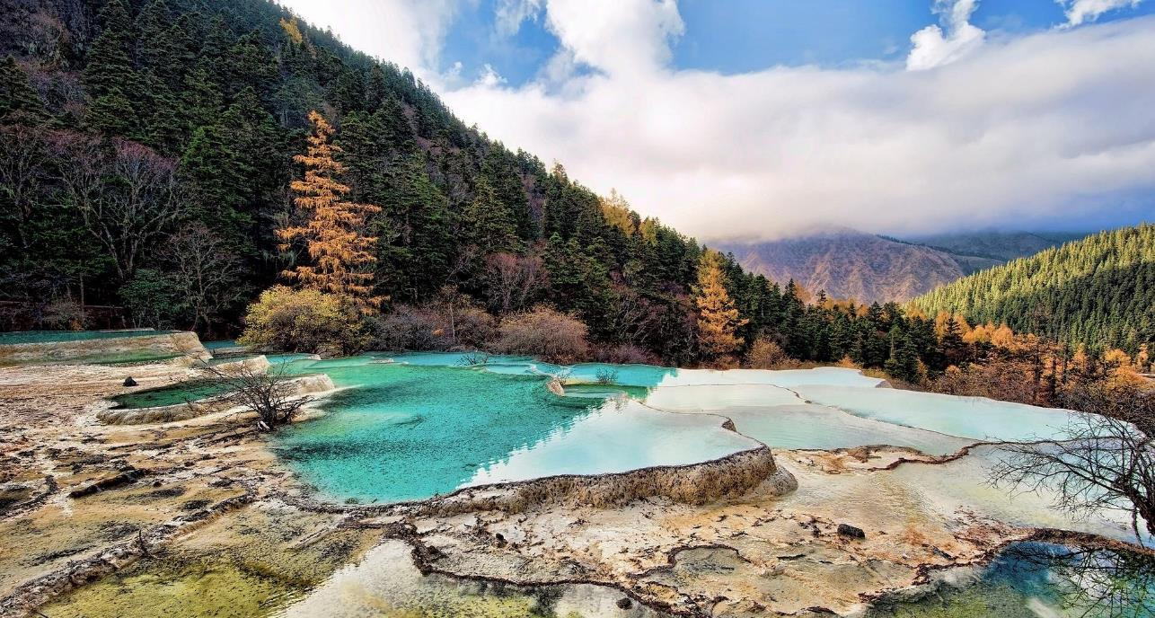
Huanglong Scenic and Historic Interest Area - Sichuan, China
黄龙风景名胜区-中国四川
Notes:
------------
Photo of Huanglong Scenic and Historic Interest Area; Huanglong Ancient Temple
https://en.wikipedia.org/wiki/Huanglong_Scenic_and_Historic_Interest_Area#/media/File:Huanglong_ancient_temple.jpg

Slide 7
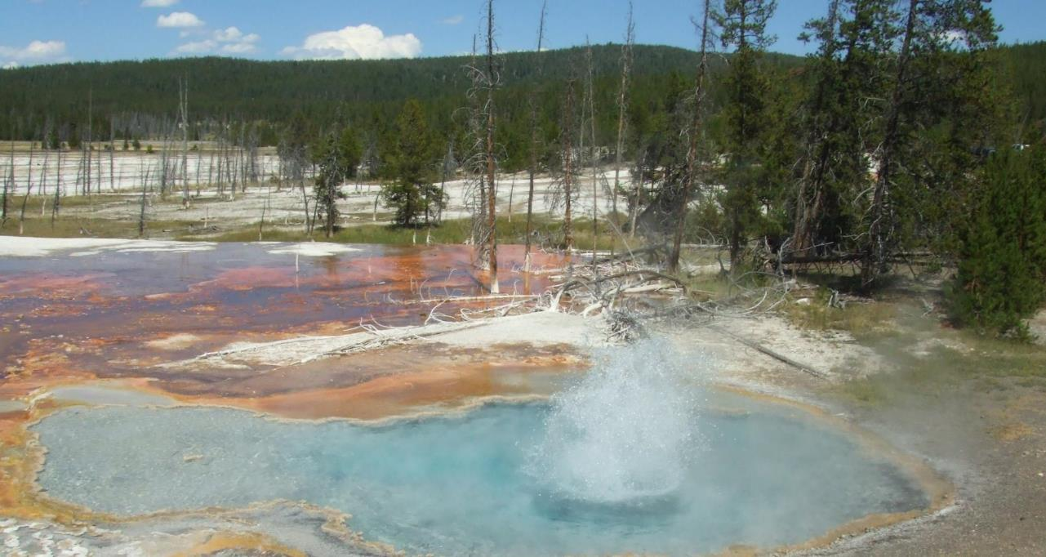
Yellowstone National Park – Wyoming, USA
黄石国家公园- 美国怀俄明州
Notes:
We have many types of protected areas in the national park system and today I will refer to all of them as “parks.”
------
Photo of Yellowstone National Park – Wyoming, USA

Slide 8
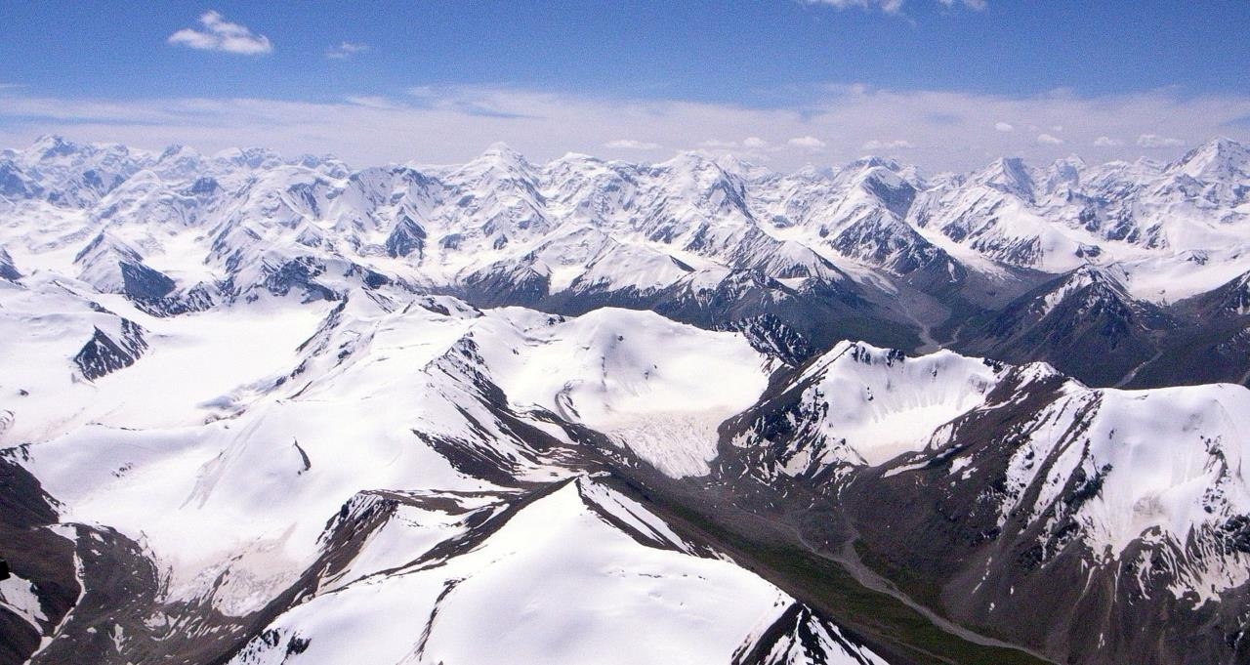
Tian Shan mountains, Bogeda Biosphere Reserve - Xinjiang, China
中国新疆博格达生物圈保护区，天山
Notes:
One thing that unites all of these special places is the importance of clean air.
-----------
Photo of Tian Shan range, crossing People's Republic of China, Pakistan, India, Kazakhstan, Kyrgyzstan and Uzbekistan
https://en.wikipedia.org/wiki/Bogeda_Biosphere_Reserve#/media/File:%E9%A3%9E%E8%B6%8A%E5%A4%A9%E5%B1%B1_fly_over_Tian_Shan_mountains_(4117410958).jpg

Slide 9
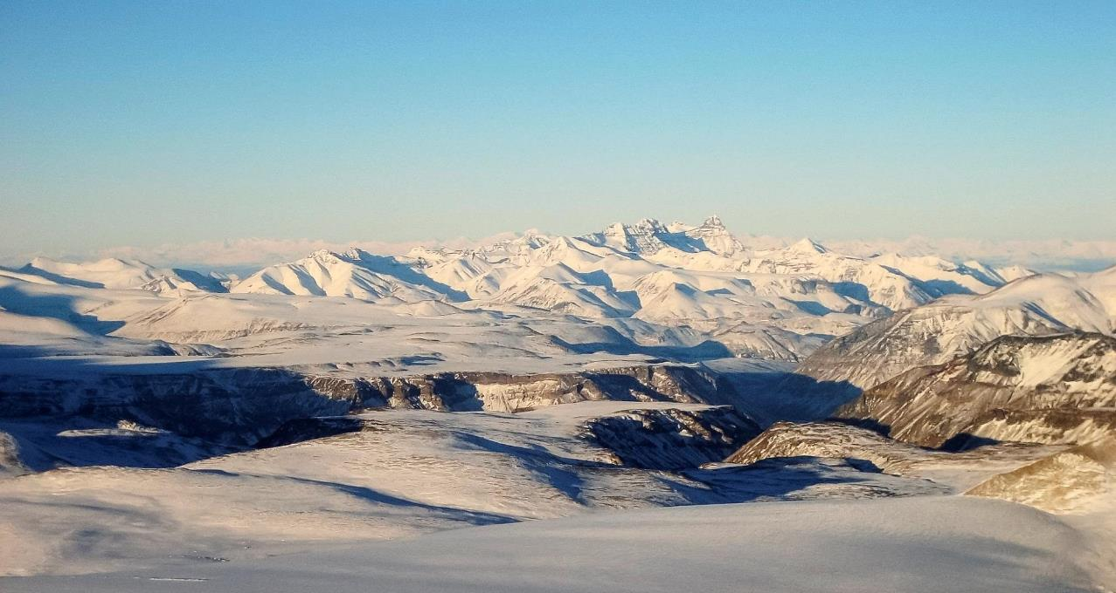
Wrangell-St. Elias National Park – Alaska, USA
美国阿拉斯加， 兰格尔-圣伊莱亚斯国家公园
Notes:
Clean air is essential to the health of park visitors and staff, for crisp clear views, and for healthy ecosystems.
-------
Photo of Wrangell St. Elias National Park – Alaska, USA

Slide 10
Air Quality Basics
空气质量基础知识
What is Air Pollution? Why does It Matter for Parks?
什么是空气污染？为什么和公园有关系？
Notes:
Before we talk more about national parks and air quality let’s take a few minutes to cover the basics.
What is air pollution?
Why does it matter for parks?

Slide 11
Air Pollution
Gasses, liquids, or particles in the air that can have serious effects on human health, wildlife, vegetation, lakes, streams, soils, and clarity of the air (i.e., “visibility”)
空气污染： 空气中可能对人类健康、野生动物、植被、湖泊、溪流、土壤和空气清晰度(即“能见度”)有严重影响的气体、液体或颗粒。
Notes:
Air pollution consists of gasses, liquids, or particles in the air that can have serious effects on human health, wildlife, vegetation, lakes, streams, soils, and visibility. Cultural resources can also be affected.
Whether an air pollutant is a problem depends on how much there is of it, how long it stays around.

Slide 12
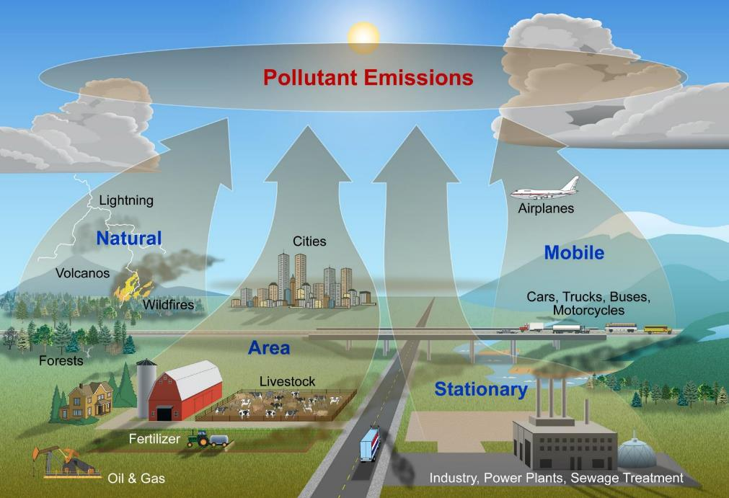
Notes:
The majority of the air pollution that affect parks DOES NOT come from the parks.
Instead, a lot of air pollution is produced by industrial processes and fossil fuel combustion to generate electricity or power transportation.
Other big sources of air pollution include agriculture (animal waste, chemical insecticides, fertilizers), oil and gas extraction, and cities.
Some air pollution also comes from natural sources such as wildfires, volcanoes, forests, and even lightning.

Slide 13
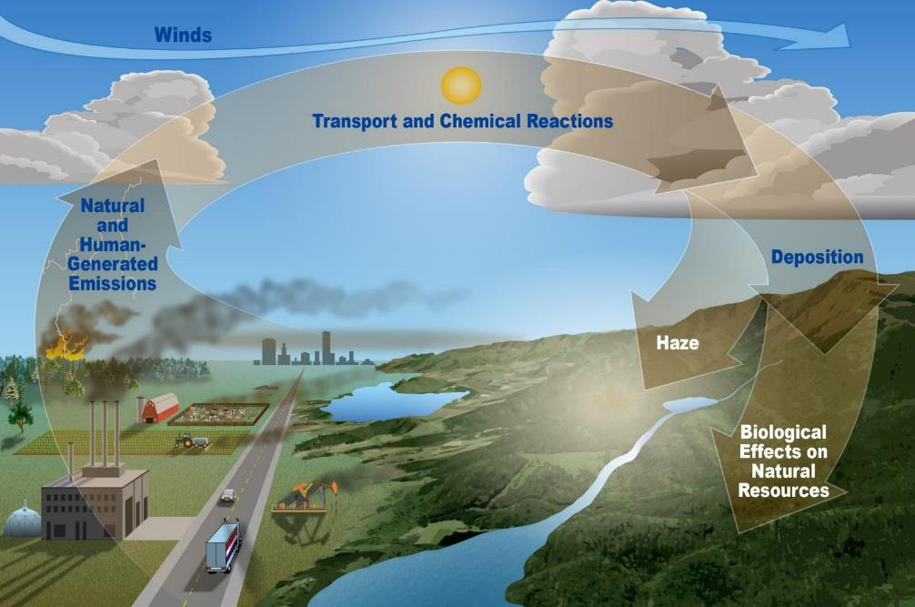
Notes:
Air pollution does not usually stay where it is created.
Pollution is transported through the atmosphere by wind before having effects further away.
Local and regional sources are often most influential. More distant transport of pollution can occur on continental to global scales. We can trace some of the pollution in US national parks to sources in Asia.
The effects of air pollution include visible haze as well as harm to human health and natural resources.

Slide 14
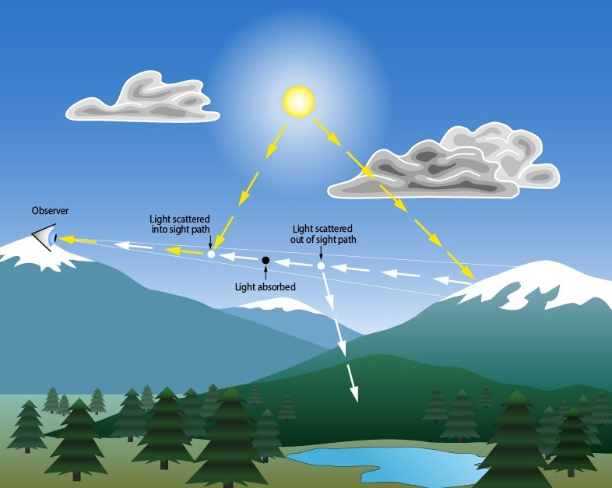
Haze limits visibility
雾霾影响能见度
Notes:
Haze can be the easiest effect of pollution to understand because it is visible.
Particles in the air limit how well you can see by scattering light into and out of your sight path.
Many visitors come to national parks to experience the scenic views so haze is a big concern for us.

Slide 15
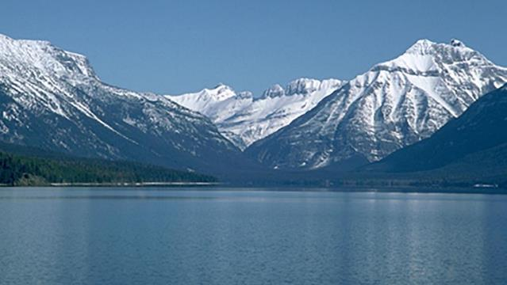
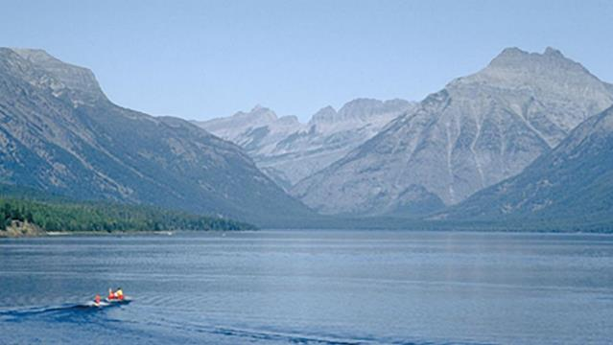
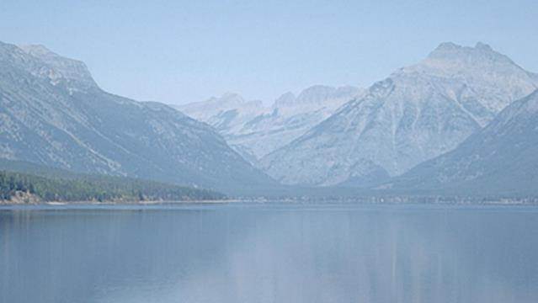

Haze Effects
美国蒙大拿州冰川国家公园
Glacier National Park – Montana, USA
Notes:
These images show how different levels of air pollution haze affect the quality of the view at Glacier National Park in Montana.
Even small ammounts of haze (well below levels that are considered unhealthy) can dull or even hide landscape features that many parks were established to protect and share.
----------
Upper left: very low fine aerosol concentration, Upper right: Fine aerosol concentration = 12 mg/m3
Lower left: fine aerosol concentration = 21.7 mg/m3, Lower right: fine aerosol concentration = 65.3 mg/m3

Slide 16
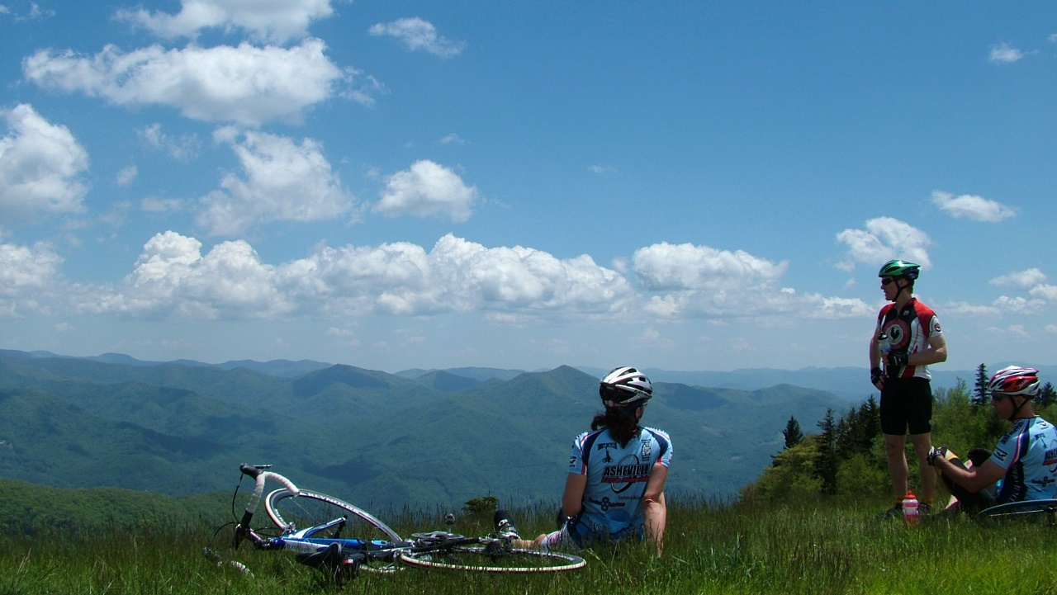


Human Health Effects
对人健康的影响
Blue Ridge Parkway – North Carolina, USA
美国北卡罗来纳州蓝岭公路
Notes:
Air pollution can be harmful to heart and lung health for people. In parks this is a concern for our staff and visitors.
Children, older adults, active people, and people with lung disease (such as asthma) are especially sensitive to air pollution. These groups are advised to reduce prolonged or heavy exertion outdoors when pollution levels are elevated. At high enough levels all people are advised to take this advice or avoid exposure by staying indoors.
Clear air is not always directly correlated with healthy air because some pollutants such as ozone are not visible.

Slide 17

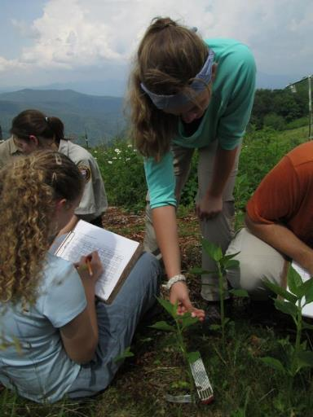
Effects on Nature
对自然的影响
Notes:
Air pollution can also harm plants. Plants respire through their leaves and polluted air can damage leaves reducing growth and in some cases survival.
--------
Photos: Students studying ozone damage on plant leaves at an ozone garden in Great Smoky Mountains National Park, North Carolina (2017). Milkweed plant leaves showing healthy, moderate, and serious ozone damage, leaves from Shenandoah National Park, Virginia.

Slide 18
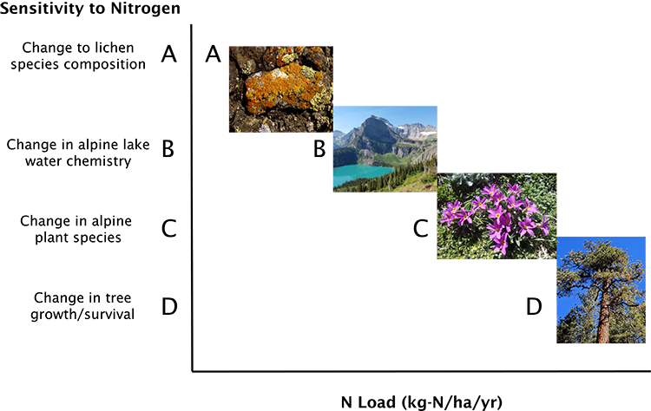
Effects on Nature
对自然的影响
Notes:
We have observed different effects in parks that correspond to the amount of pollution.
With increasing levels of pollution larger scale effects are observed. Even very small amounts of pollution can disrupt sensitive ecosystems by altering food chains.
In some places pollution encourages non-native species, this can be bad for biodiversity.

Slide 19
NPS Responsibilities & Actions
国家公园的责任与行动
Legal Authorities and Our Programs for Clean Air
法定机构和我们的清洁空气项目

Slide 20
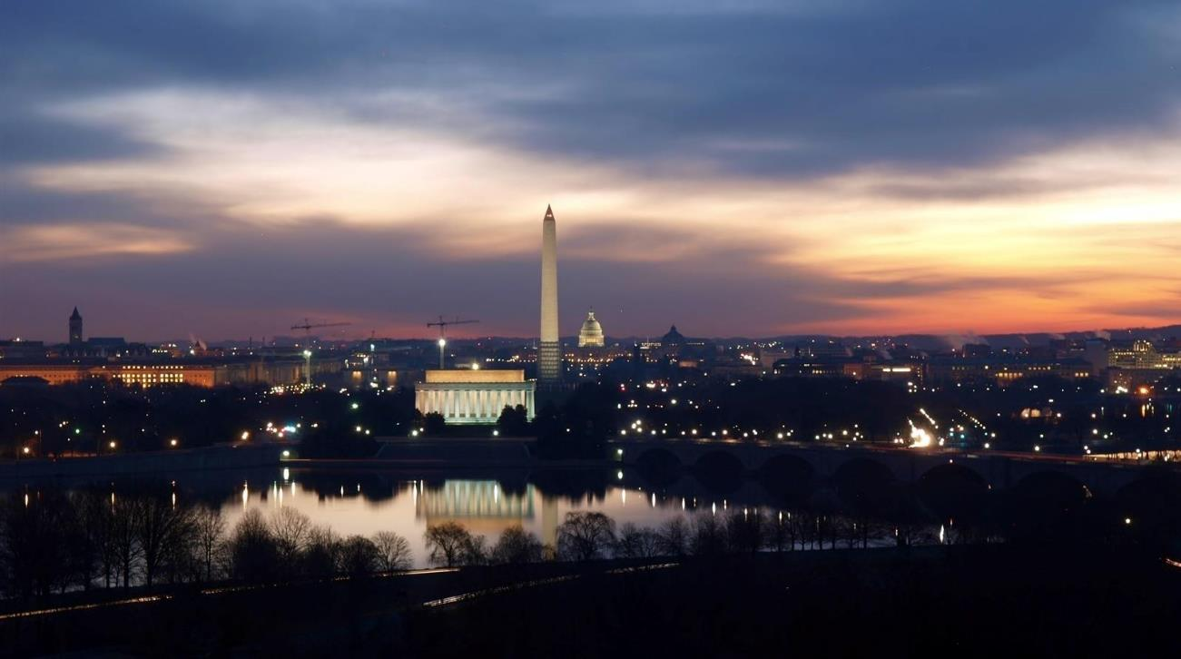
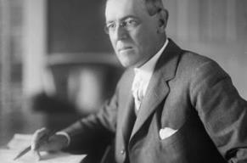



1916 NPS Organic Act
1970 Clean Air Act
1916年 国家公园管理局组织法
1970年 清洁空气法案
1977 Clean Air Act Amendments
1990 Clean Air Act Amendments
1977年 清洁空气修正案
1977年 清洁空气修正案
Notes:
The NPS has an affirmative legal responsibility to protect clean air in national parks.
1916 NPS Organic Act: created the agency with the mandate to conserve the scenery, natural and cultural resources, and other values of parks in a way that will leave them unimpaired for the enjoyment of future generations. This statutory responsibility to leave National Park Service units “unimpaired,” requires us to protect all National Park Service units from the harmful effects of air pollution.
In the 1970 Clean Air Act: authorized the development of comprehensive federal and state regulations to limit emissions from both stationary (industrial) sources and mobile sources. The Act also requires the Environmental Protection Agency to set air quality standards.
1977 Clean Air Act Amendments: these amendments to the Clean Air Act provide a framework for federal land managers such as the National Park Service to have a special role in decisions related to new sources of air pollution, and other pollution control programs to protect visibility, or how well you can see distant views. The Act established a national goal to prevent future and remedy existing visibility impairment in national parks larger than 6,000 acres and national wilderness areas larger than 5,000 acres that were in existence when the amendments were enacted.
1990 Clean Air Act Amendments: created regulatory programs to address acid rain and expanded the visibility protection and toxic air pollution programs. The acid rain regulations began a series of regional emissions reductions from electric generating facilities and industrial sources that have substantively reduced air pollutant emissions.

Slide 21
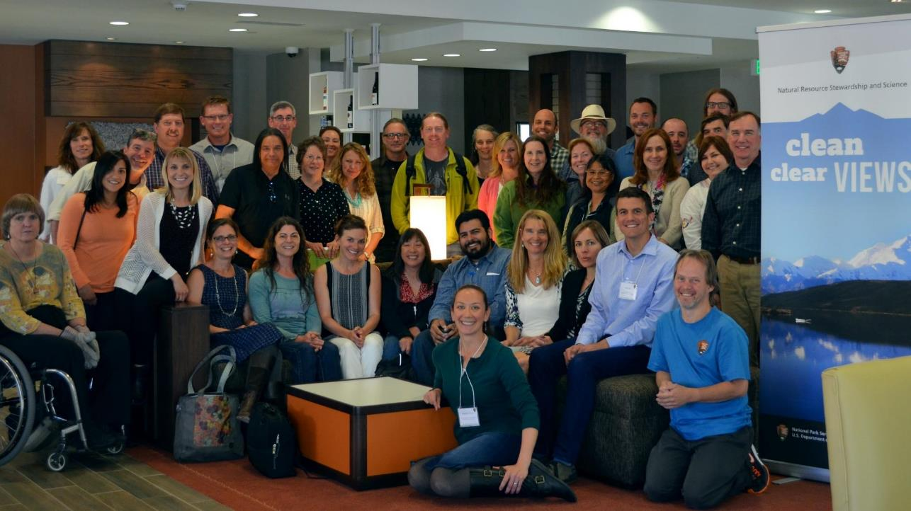
Notes:
We at the NRSS Air Resources Division are a team of scientists, lawyers, and resource professionals. As a group, which includes staff from parks and regions as seen here, we spend our time and energy working to achieve clean air and clear views for parks.
We have 40+ years of air quality experience in parks. We have:
Established a robust continuous network of air quality monitors across the NPS
Conducted and supported air pollution research in parks across the country to understand effects on parks and visitors.
Launched a visual resources program for management of scenic views associated with parks, both inside and beyond park boundaries.
Worked with states and other federal agencies to review thousands of air quality permits, plans, and regulations in order to reduce air pollution.
Developed interpretive displays and public outreach on the importance of clean air and scenic views to park visitors.

Slide 22
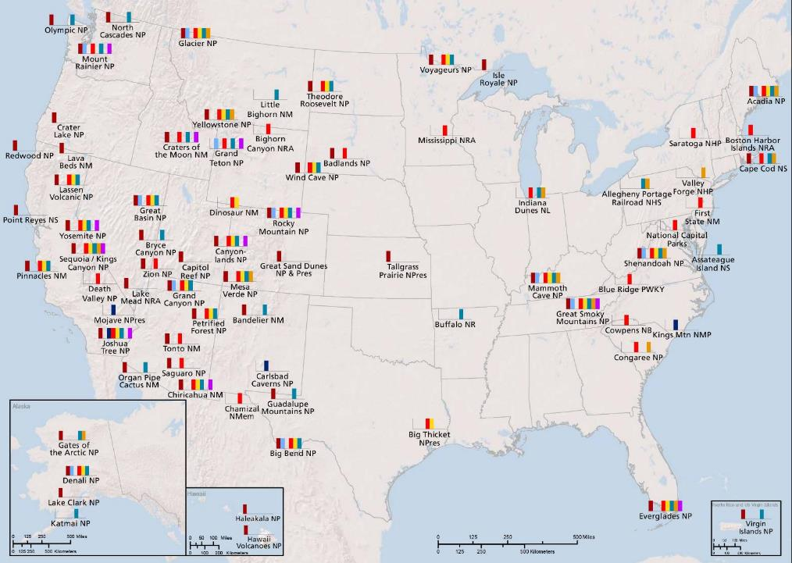

Monitoring
监控
Visibility (Filters)
Visibility (Optical)
Ozone
Ozone (Portable)
Deposition (Dry)
Deposition (Wet)
Mercury
Ammonia
能见(过滤)
能见度(光学)
臭氧
臭氧(便携式)
沉积(干)
沉积(湿)
汞
氨
Notes:
The NPS measures air pollution in many national parks. Our air quality monitoring is done in partnership with nationwide air quality monitoring networks. Our data collection uses the quality standards of these networks and can be used for implementing regulations. We have one of the most robust networks of rural air quality monitoring in the world.
---------
Map showing the location and type of air quality monitoring in national park service areas.

Slide 23
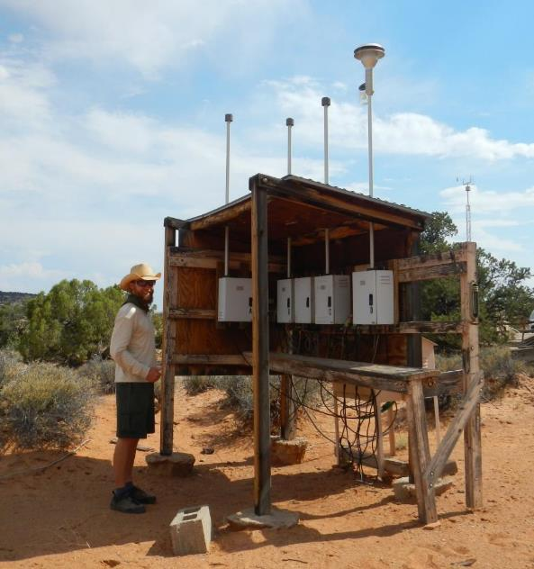
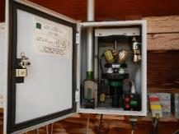
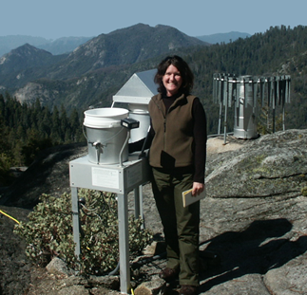
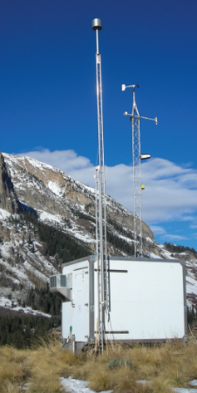
Monitoring
监控
Notes:
Many of our parks have been collecting data for more than 40 years.
------------
Photos of monitoring equipment in parks.

Slide 24

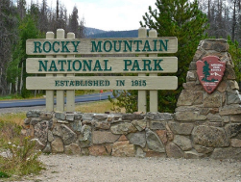


Research
科研
Notes:
We support and participate in research that helps identify sources of pollutants and understand pollution transport processes. In 2014 the NPS joined several other agencies studying pollution in the front range of Colorado with implications for Rocky Mountain National Park.
-------
Background photo of the Denver, Colorado skyline. Inset photos of the Rocky Mountain National Park entrance sign, sampling campaign equipment, and a mobile air quality laboratory van.

Slide 25
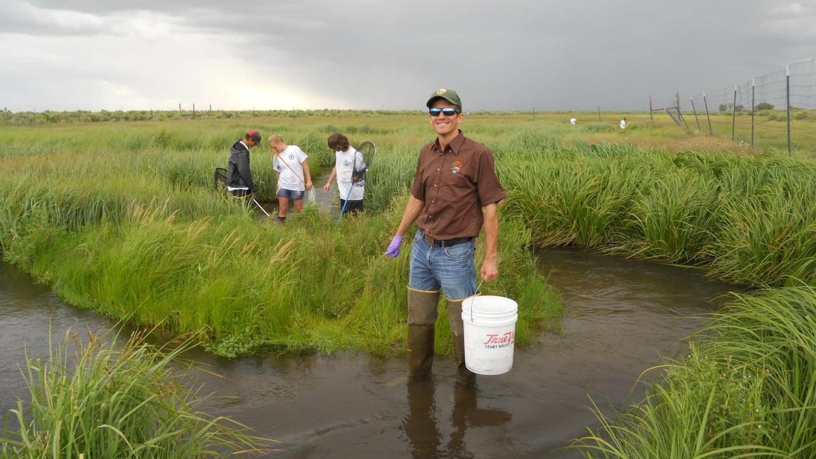
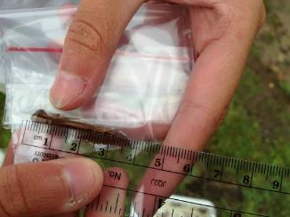
Research
科研
Notes:
We undertake research related to the effects air pollution has on aquatic habitats and wildlife, including dragonfly larvae.
----
Photos of dragonfly larvae sampling at Great Sand Dunes National Park – Colorado, USA.

Slide 26
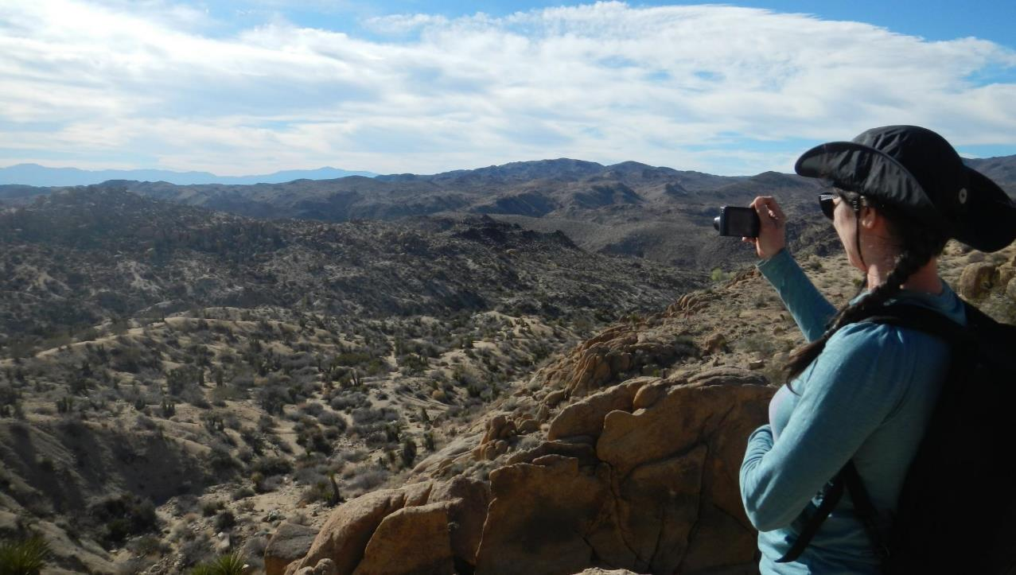
Scenic Views
风景
  Scenic
  Quality
风景质量
  View Importance
视野的重要性
Notes:
Work to protect scenic views from air pollution + from conflicting land uses.
The NPS values both scenic quality (the aesthetic value of views) and the cultural/historical importance of views to why the US created individual parks.
The NPS takes steps to protect views, both inside and beyond park boundaries, that are important to the visitor.
------
Photo of Joshua Tree National Park – California, USA

Slide 27
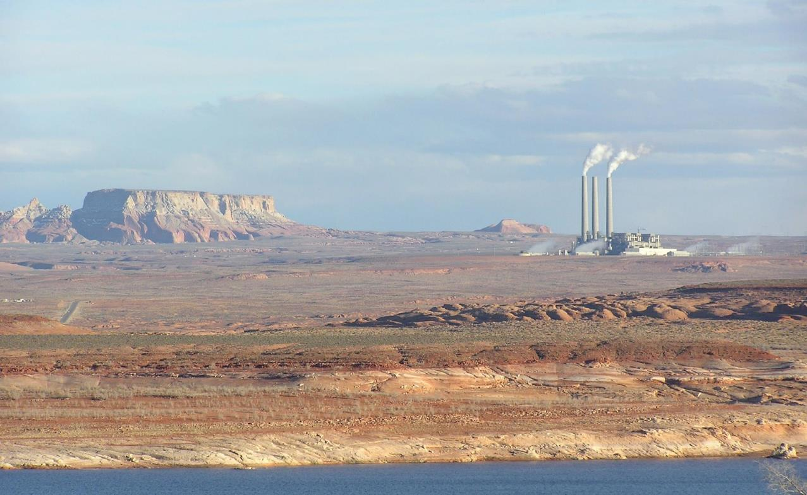
Policy & Permit Review
政策和许可审查
Notes:
We work with other federal agencies (like the US Environmental Protection Agency), States, industry, and non-governmental groups to reduce air pollution emissions that affect parks by having industry install pollution controls on new and existing facilities.
We also advocate for strong regulations and guidance documents to advance clean air in units of the national park system.
Health based air quality standards
Controls of mobile sources
Addressing regional haze
Site specific permitting actions – either by states of industrial facilities or other federal agencies in issuing federal oil and gas leases
Air is not restricted by park boundaries. So, whenever we make improvements to protect a specific park it also improves air quality in surrounding parks and communities.
------
Photo of the Navajo Generating Station in Paige, Arizona near Grand Canyon National Park.

Slide 28
Air Quality in Parks
公园内的空气质量
How Are We Doing?
Air Clarity, Ozone, Nitrogen & Sulfur Deposition, Mercury Deposition
我们怎么保证空气质量的呢？
空气清晰度、臭氧、氮和硫的沉积、汞
Notes:
How are we doing? Let’s consider 4 measures of air quality to evaluate progress:
Air Clarity (Visibility)
Ground level ozone
Nitrogen and Sulfur Deposition
Mercury Deposition
For each of these factors we can check out the trends and measure progress against benchmarks to get a pulse.

Slide 29
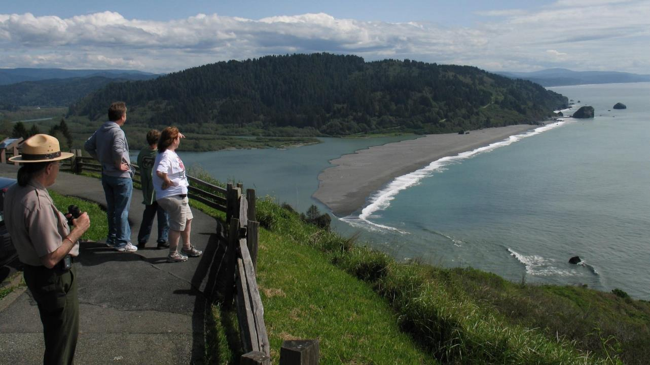
Air Clarity
空气清晰度
Visibility affects How well and how far you can see
可见性影响可看到的程度和距离
Notes:
----
Photo of Redwood National & State Parks – California, USA

Slide 30
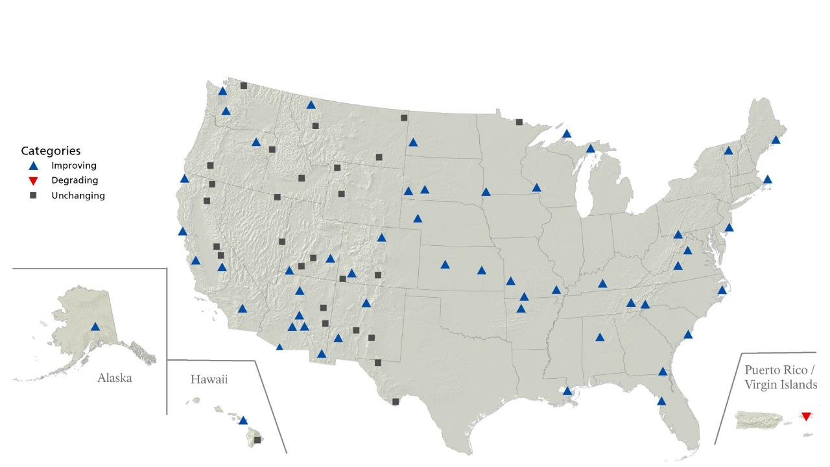
长期能见度趋势- 雾霾天
Long Term Visibility Trends – Hazy Days
改善
恶化
无变化
Notes:
I am going to show a series of maps that highlight air quality trends and conditions in parks. For these maps the symbols indicate national park service areas that have enough (10+ years) on-site or nearby data to accurately represent the parks.
This map shows hazy day visibility trends in parks. Overall we can see that trends on the haziest days are improving, especially across the Midwest and east coast.
Many of the Eastern US sites now experience half the visibility impairing pollution that they had 20 years ago.

Slide 31
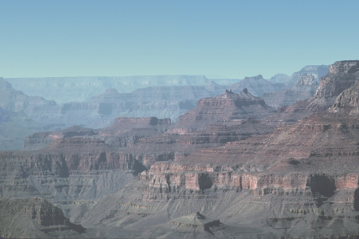
长期能见度趋势- 雾霾天
Long Term Visibility Trends – Hazy Days
1990
2015
1990
2015
Notes:
Here, inset images compare haziest days in 1990 and 2015 at Grand Canyon National Park, Arizona and at Great Smoky Mountains National Park in North Carolina and Tennessee. Both parks have experienced statistically significant improvement. The magnitude of improvement is much more noticeable for Eastern parks like Great Smoky Mountains NP.
Cleaner cars, cleaner power production with emission controls, and less high sulfur coal being burned to generate electricity are all contributing to these improvements in visibility, even on the haziest days.

Slide 32
长期能见度趋势- 雾霾天
Long Term Visibility Trends – Hazy Days
Notes:
But, in the west, there are a lot of flat trends… Why?

Slide 33
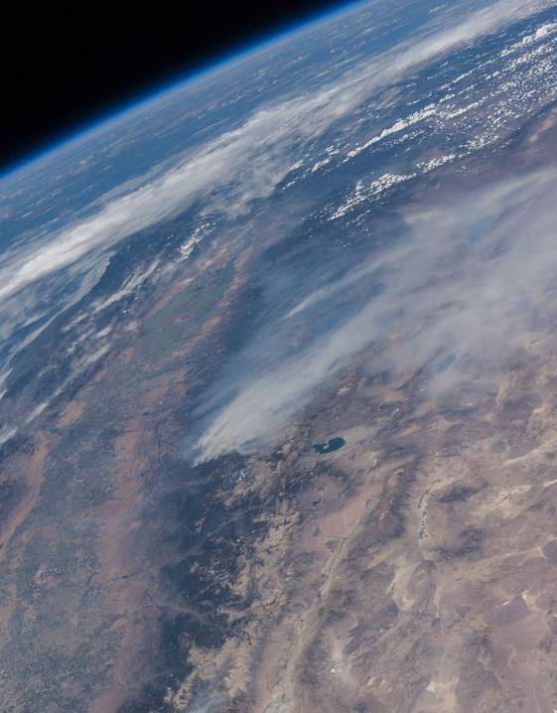
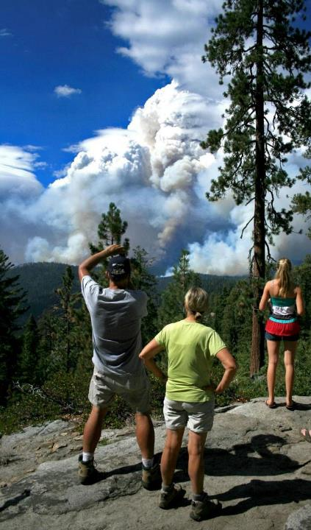
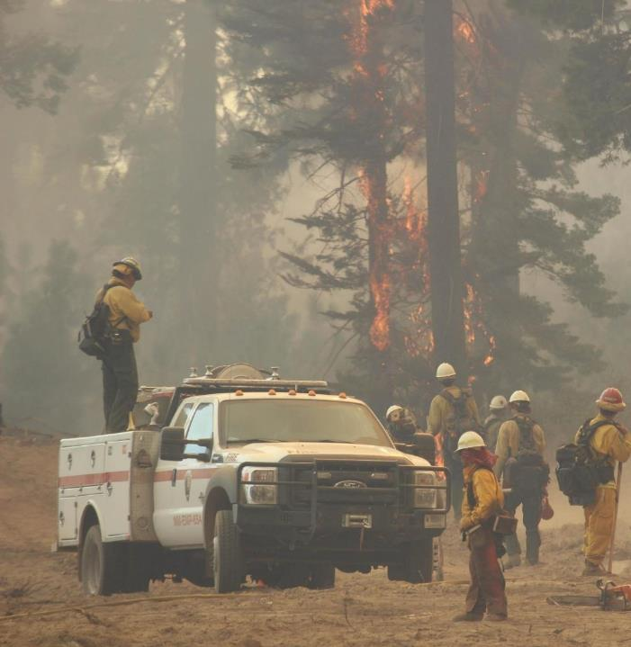
Smoke…
烟
Notes:
Smoke – Drought, climate change, a history of fire suppression have all set the stage for large wildland fires and the result is that advantages we have gained through clean cars and clean power are offset on the haziest days by wildfire smoke across much of the Western US.
Also, during the spring months some gains we have seen are being offset by pollution transport from Asia.
-----
Photos show three different perspectives on the Rim fire near Yosemite National Park, California in 2013. From left: image from the International Space station, from across the Yosemite valley, and from the fire fighters vantage point.

Slide 34
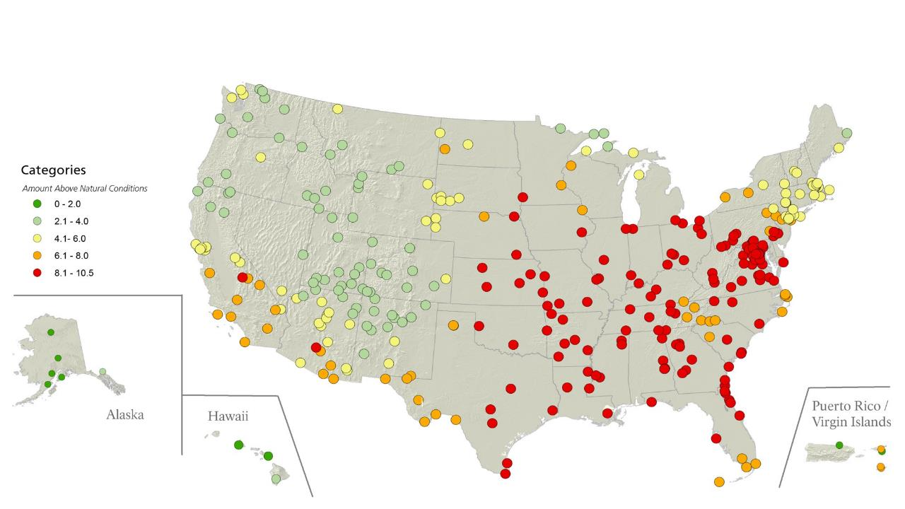
Visibility Conditions – How close to natural?
能见度情况-有多接近自然情况？
高于自然情况的数量
Notes:
Trends aside, the Clean Air Act goal is no man made impairment to visibility.
When we compare mid-range days (not the clearest or haziest) with natural conditions you can see that parks still have a long way to go to reach background (unpolluted) conditions. Many parks, especially in the intermountain west, are getting closer but there is still significant work to do.

Slide 35

Ground-Level Ozone
地表臭氧
Harmful for Human Health and Vegetation
对人的健康和植物有害
Notes:
Ground-level ozone is different from the ozone layer in the stratosphere that blocks ultraviolet radiation from the sun keeping the planet habitable. At ground-level ozone is a harmful oxidant that forms when nitrogen oxides and volatile organic compounds (VOCs) react in the presence of sunlight. It affects people’s ability to breathe and can be harmful to plant growth.
In the US, the Environmental Protection Agency regulates ozone and sets exposure limits that all states and tribal governments are responsible for achieving.
-----------
Photo of Great Sand Dunes National Park – Colorado, USA

Slide 36
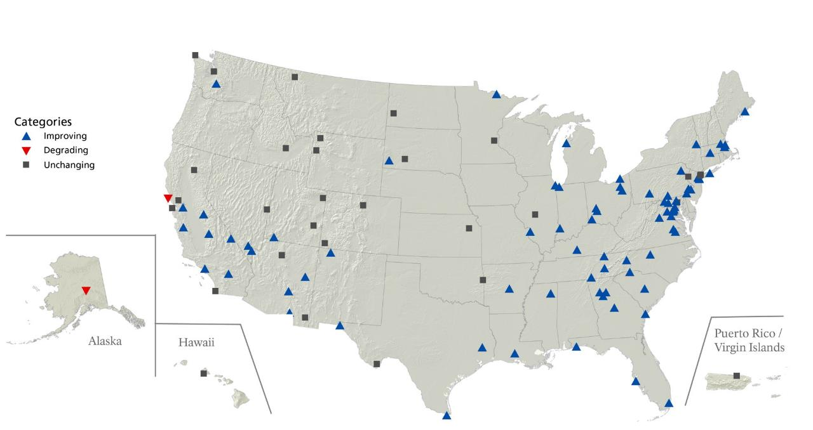
长期臭氧趋势
Long Term Ozone Trends
改善
恶化
无变化
Notes:
Long term ozone trends show that ozone concentrations are getting better almost everywhere.
There are a fair number of flat trends. These are largely influenced by fire and to some extent emissions from oil and gas development offsetting the pollution reductions that have been gained through more modern cars and emission controls on power generation.
Only two parks in the country have representative monitors that show degrading trends:
Muir Woods National Monument in California and
Denali National Park in Alaska.

Slide 37
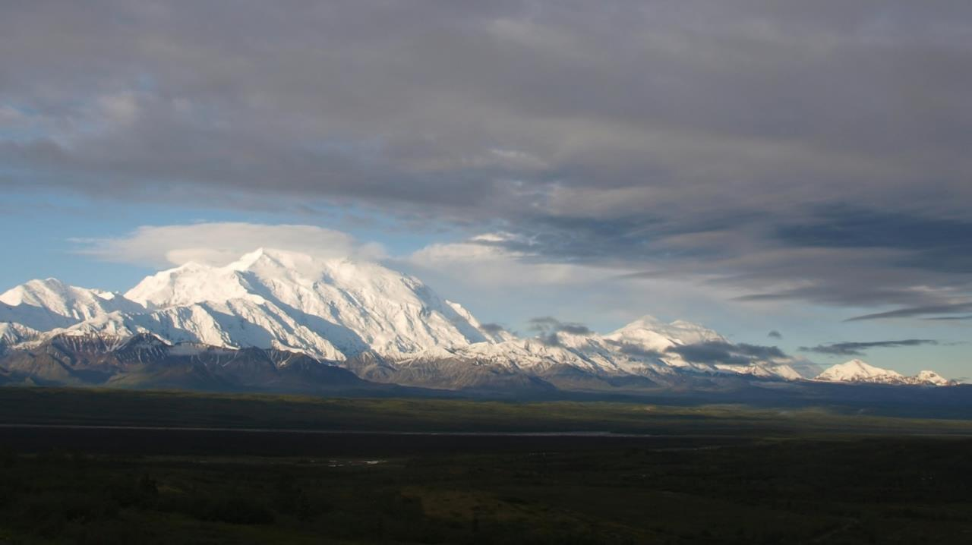
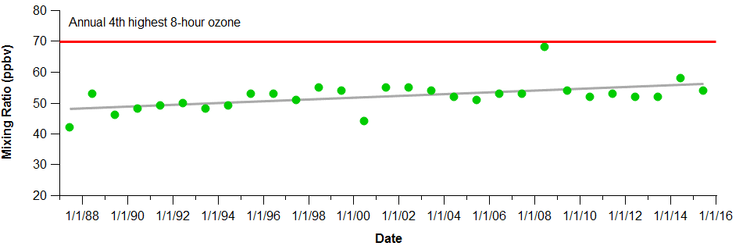
Denali National Park – Alaska, USA
丹那利国家公园， 美国阿拉斯加
Notes:
The really interesting part about Denali is that although the ozone levels are still quite low, the increasing trend is likely driven by global weather pattern shifts leading to more international transport.
Transport pathway change:
Increase in strength & longevity of La Niña events over 1999–2012
Negative Pacific Decadal Oscillation (PDO) period - increased transport of polluted air masses from East Asia by 13% from the previous PDO period (1987–1998).
------------
Photo of Denali National Park – Alaska, USA

Slide 38
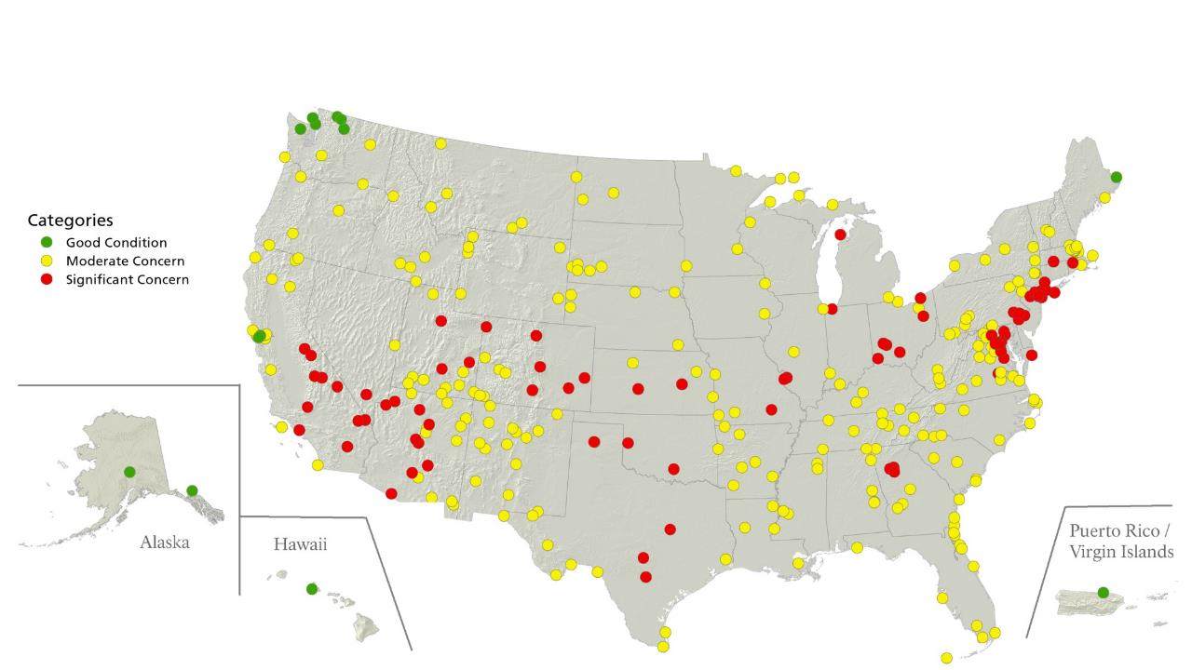
Ozone Conditions – For Human Health
臭氧条件-对人类健康影响
无影响
轻度影响
重度影响
Notes:
Comparing current ozone levels to the recently revised standards we see that there is still progress to be made here. Note that only the red parks are actually above the EPA recommended levels for human health. Fortunately many states are already on a glidepath to meet the new standard by 2020 and as they do we will start to see far fewer red circles on our map.

Slide 39
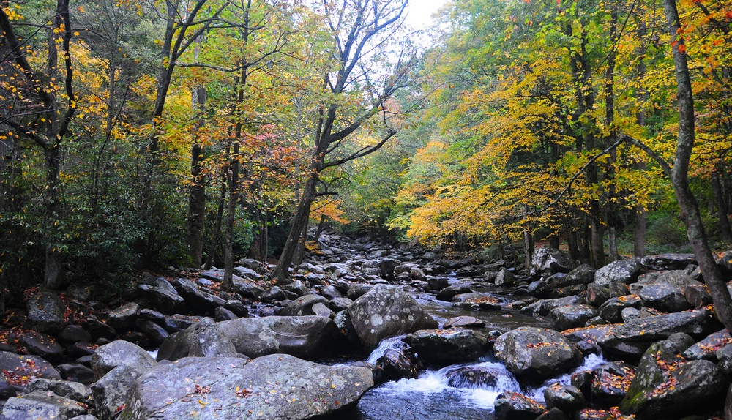
Nitrogen & Sulfur Deposition
氮硫沉积
Acid Rain & Artificial Fertilization Harm Park Plants and Streams
酸雨&人工施肥对公园植物和溪流的危害
Notes:
Nitrogen and sulfur compounds in air pollution can be washed out of the air and deposited in parks with precipitation.
“Acid rain” is the popular terminology for low pH rain resulting from this kind of air pollution. Acid rain can damage plant and forest health as well as alter lake and stream chemistry, which in turn can lead to conditions where native fish and amphibians can not survive.
At lower levels of nitrogen deposition artificial fertilization occurs. Nitrogen is used in agriculture as a fertilizer and is emitted from animal feeding operations. When nitrogen is deposited through precipitation it can lead to changes in aquatic biota. Weedy invasive species may respond to an influx of nitrogen by crowding out native plants.
-----------
Photo of Great Smoky Mountains National Park – North Carolina and Tennessee, USA

Slide 40
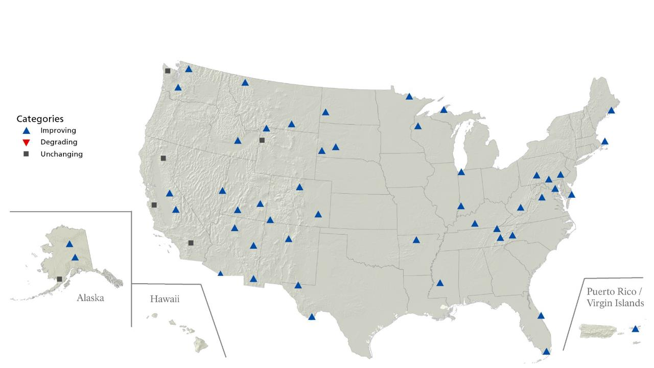
硫酸盐长期趋势-浓度
Long Term Ozone Trends – Human Health
Long Term Sulfate Trends – Concentration
改善
恶化
无变化
Notes:
Long term trends for sulfate show improvement almost everywhere.
This is largely thanks to emission controls on power plants that were required by the acid rain regulations that resulted from 1990 clean air act amendments.

Slide 41
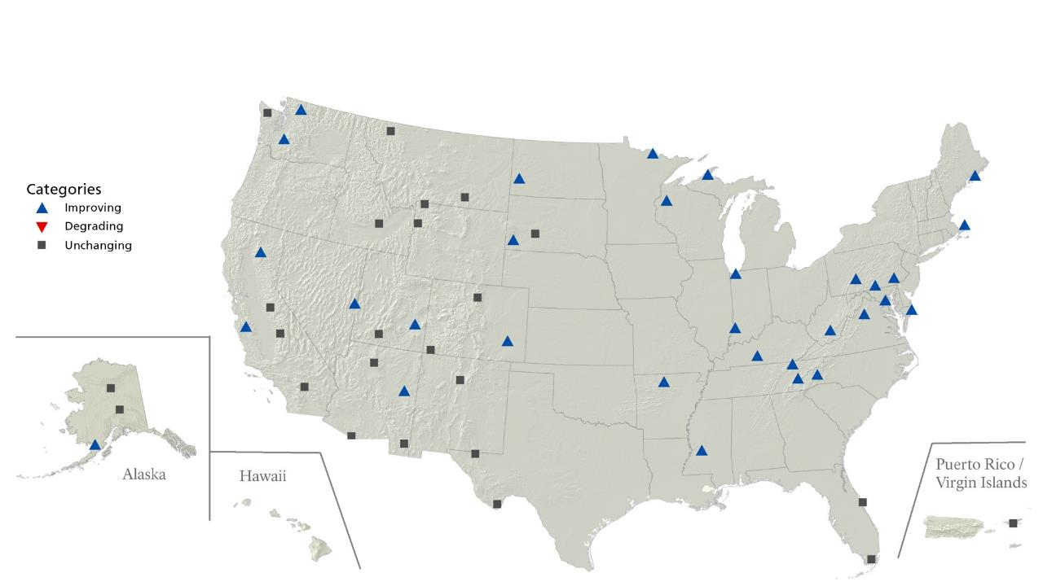
硝酸盐长期趋势-浓度
Long Term Ozone Trends – Human Health
Long Term Nitrate Trends – Concentration
改善
恶化
无变化
Notes:
Nitrate deposition also was dramatically improved by these regulations and additionally by stricter vehicle emissions standards that have been incrementally implemented since the 90’s.

Slide 42
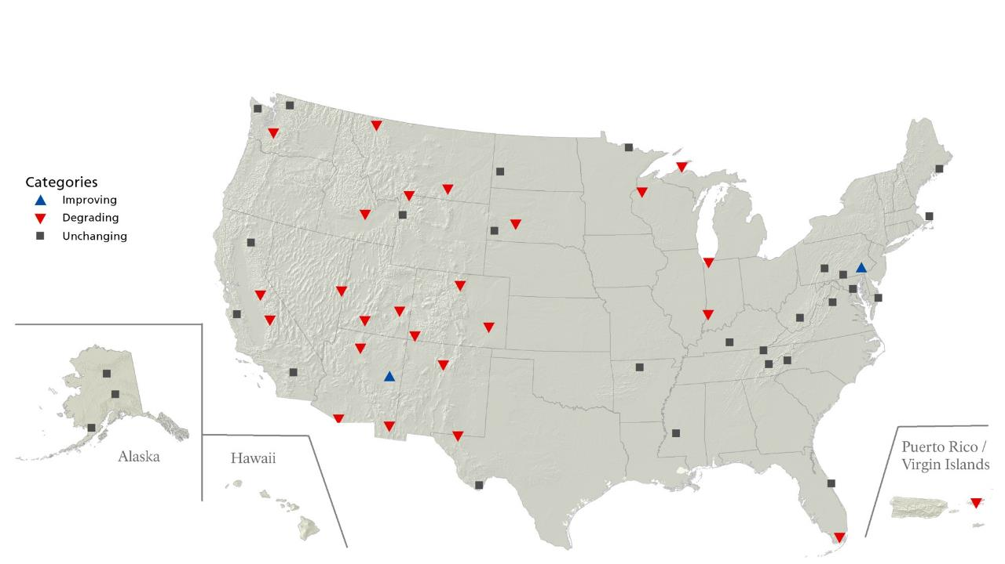
铵盐长期趋势-浓度
Long Term Ozone Trends – Human Health
Long Term Ammonium Trends – Concentration
改善
恶化
无变化
Notes:
Ammonium on the other hand is a nitrogen compound that shows increasing trends in many parts of the US.
Ammonium is a pretty big deal and it is getting worse in part because there are no regulations on Ammonium emissions.

Slide 43

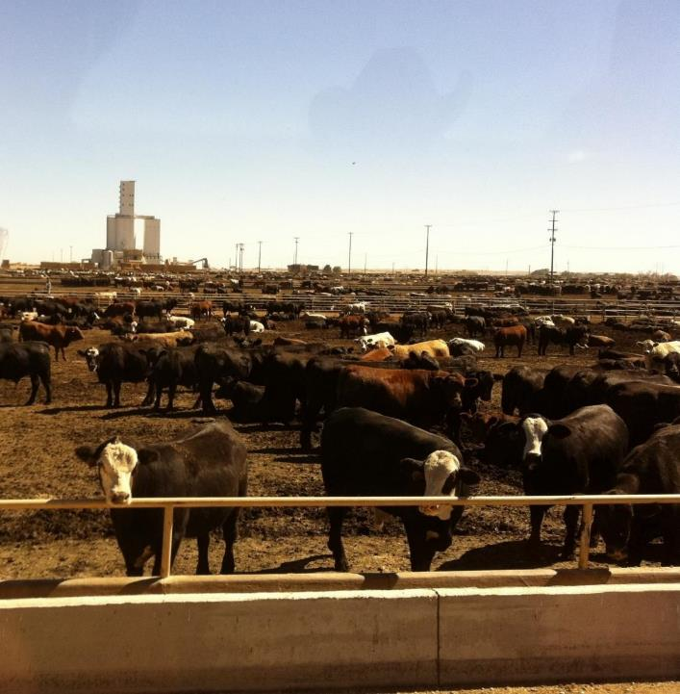

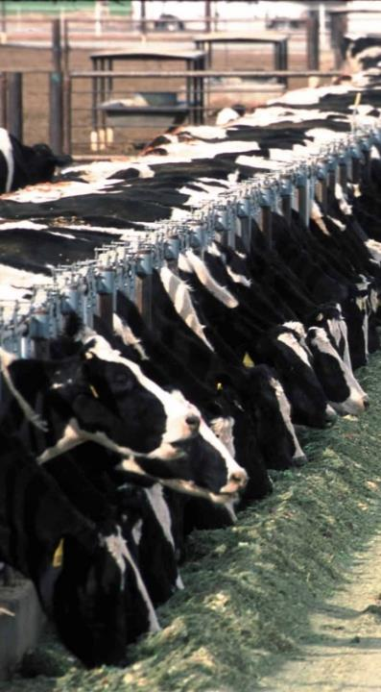
Ammonium…
铵盐…
Notes:
The vast majority of ammonium emissions are coming from agriculture. A shift to more confined animal feeding operations and large scale industrial agriculture in the past two decades has had a measurable and concerning effect on the amount of nitrogen entering the atmosphere and in turn being deposited in parks.

Slide 44

Atmospheric Mercury Deposition
大气汞沉积
Mercury can build up in the food chain Harming Wildlife and People
汞可以在食物链中积累，危害野生动物和人类
Notes:
Mercury emissions from fossil fuel combustion and industrial processes travel through the air just like other pollutants and are deposited in park ecosystems. Once mercury enters park soils and waters it can convert to its toxic form which builds up the food chain affecting park wildlife, especially higher order predators.
---------
Photo of Katmai National Park and Preserve – Alaska, USA

Slide 45
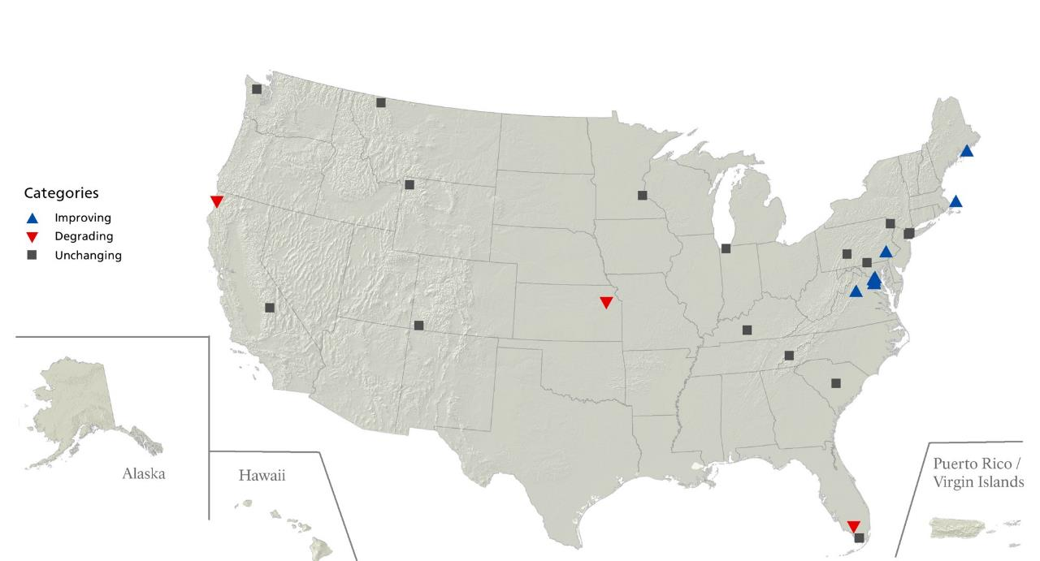
贡长期趋势-浓度
Long Term Ozone Trends – Human Health
Long Term Mercury Trends – Concentration
改善
恶化
无变化
Notes:
We have far less data and therefore fewer trends for Mercury than for other parameters.

Slide 46
Partnership Opportunities
合作机会
Developing Common Understanding
发展共识
Notes:
We would very much like to work with the Chinese National Parks in the future to share monitoring techniques and improve understanding of global atmospheric processes. We will be happy to share our experience, methodology, and data in future communications. We hope this is a partnership you will seriously consider.

Slide 47



















Partnerships
合作伙伴
Notes:
Because air transcends boundaries, forging effective partnerships is critical to our success in protecting and ever improving the air quality in our national parks.
Also, partnerships are essential for protecting scenic views that extend beyond park boundaries.

Slide 48
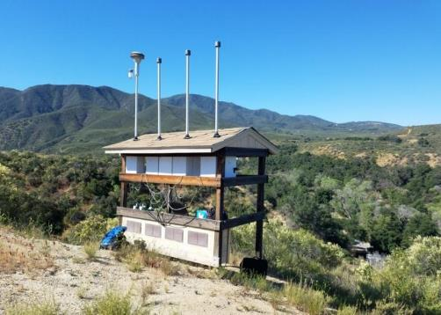
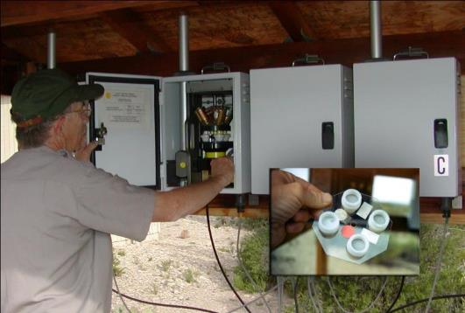
Visibility Monitoring
能见度监控
24-hr samples, every 3rd day
每隔3天24小时采样
Notes:
One opportunity for our partnership may be through our IMPROVE (Interagency Monitoring of Protected Visual Environments) visibility monitoring program. There are over 150 sites in the US and there have been a few international sites as well. While not currently operating we have recently had sites operating in Canada and South Korea.
We would like to explore with you the opportunity to have Chinese National Parks conduct this same kind of visibility monitoring, as well.
-------
Photo of a visibility monitoring station and inset of a site operator changing filters.

Slide 49
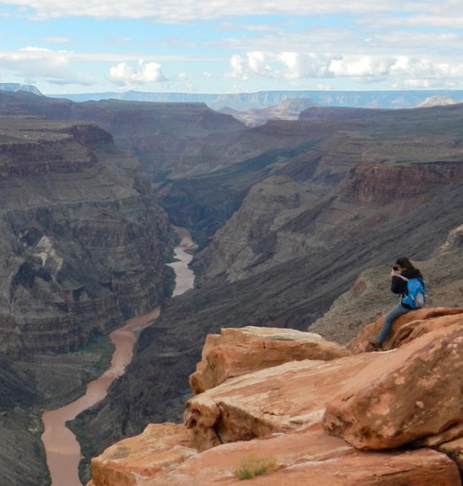
Learn More
更多
nps.gov/air
  Live Data
    Ozone & Meteorology
    Webcams
  Conditions & Trends
    National Data
    By Park
Notes:
If you are interested in learning more about air quality in parks, please feel free to call or peruse our webpages. We make all of our data available to parks and the public.
Links:
Home page - https://www.nps.gov/subjects/air/index.htm
Live data - https://www.nps.gov/subjects/air/current-data.htm
Webcams - https://www.nps.gov/subjects/air/webcams.htm
Conditions & Trends, National Summary - https://www.nps.gov/subjects/air/national-summary.htm
Conditions & Trends by Park - https://www.nps.gov/subjects/air/webcams.htm
Park Air Profiles - https://www.nps.gov/subjects/air/airprofiles.htm
Organizational home page - https://www.nps.gov/orgs/1971/index.htm
Organizational contacts - https://www.nps.gov/orgs/1971/contactus.htm
----------
Photo of Grand Canyon National Park – Arizona, USA

Slide 50
Water Resources & Parks
水资源&公园
A Brief overview
概述

Slide 51
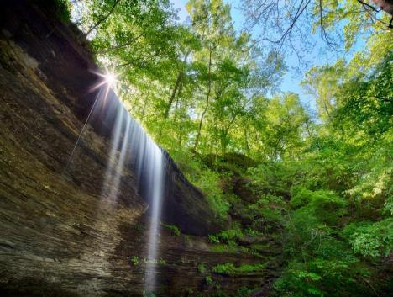

Parks Need Water!
公园需要水！
Water Supply
Ecosystem Health
Recreation
Cultural & Historic Uses
Scenic Views
Private uses where rights exist
供水
生态系统健康
游憩
文化和历史用途
风景
授权的私人用途

Slide 52




Water Resource Specialties
与水资源有关
  Hydrology, including ground water
  Water Quality
  Fisheries
  Wetlands Restoration & Mitigation Banking
  “Water Rights” & Policy Support
水文学，包括地下水
水质
渔业
湿地修复 & 湿地补偿银行
“水权”和政策支持

Slide 53




Water Resource Specialties
  Aquatic Invasive Species
  Wild and Scenic Rivers
  Monitoring/Condition Assessments/Data Mgt
  Water Education & Public Outreach
水生入侵物种
自然和风景河道
监测/状况评估/数据管理
水教育和公共宣传

Slide 54

Protecting Water
保护水资源
Legal Basis
  Organic Act
  Clean Water Act
  Coastal Zone Management Act
  Safe Drinking Water Act
Scientific and Technical Expertise
Partnerships
法律基础
组织法
水清洁法案
沿海地区管理条例
安全饮用水法案
科学和技术专家
合作
Notes:
---------------
Photo of Glen Canyon National Recreation Area, Utah.

Slide 55




Water Resources TEAM
水资源队伍
Centralized Office AND Field Based Positions
中央办公室和野外站点

Slide 56

“If there is magic on this planet, it is contained in water.”
– Loren Eiseley
Contact: Ed Harvey
Chief, Water Resources Division
Forrest_Harvey@nps.gov 970-225-3511
请联系：艾德·哈维，水资源部部长
Notes:
----------------
Photo from the NPS Protecting Water Webpage (https://www.nps.gov/subjects/protectingwater/index.htm)

Slide 57

Questions ?
Yosemite National Park – California, USA
Notes:
------
Photo of Yosemite National Park – California, USA

