Slide 1
America’s National Park System Governing Law and Context
美国国家公园系统- 法治和背景
John D. Leshy
Professor Emeritus
University of California, Hastings College of the Law
Former Solicitor (General Counsel) U.S. Department of the Interior
(1993-2001)
Vice Chairman of the Board, The Wyss Foundation
September 5, 2019
约翰·D·莱西
荣誉退休教授
伯克利哈斯汀法学院
美国内政部前律师(总法律顾问)(1993-2001年)
维斯基金会董事会副主席

Slide 2
By way of background, I visited China, including Kunming and Northwest Yunnan, in 2001.
2001年，我访问了昆明和云南西北部。
Hiked into Yubeng, at foot of Kawagarbo in the Meili xueshan Range, while visiting my close friend Ed Norton, who was then head of The Nature Conservancy’s Yunnan Great Rivers Project, based in Kunming.
Also met with Ed’s then assistant, Rose Niu, who is now with Paulson Institute.
I was traveling with Hansjorg Wyss, a connection I will explain at the end of my remarks.
我去探望我的好友埃德·诺顿时，徒步走进梅里雪山，主峰卡瓦格博峰山脚下的雨崩村。埃德当时是自然保护协会云南大河项目的负责人，总部设在昆明。
还认识了当时埃德的助手牛红卫女士，她现在保尔森基金会工作。
同行的还有汉斯约尔格·维斯，和他的关系我将在演讲结束时解释。

Slide 4
Basic Purposes of U.S. National Park System
[from 1916 legislation establishing the System, and the National Park Service to administer it.]
“To conserve the scenery and the natural and historic objects and the wild life therein and to provide for the enjoyment of the same in such manner and by such means as will leave them unimpaired for the enjoyment of future generations.”
美国国家公园系统的基本目的
[1916年立法建立国家公园体系，并由国家公园管理局来管理它。]
（委托该机构）保护风景区、自然环境、野生动物和历史文物，并以同样的精神和方式为人们提供精神上的享受，也要以同样的手段为美国的子孙后代们妥善保护这些，使之不受损坏，并带给他们享受。

Slide 5
There is tension between (a) providing for public “enjoyment” of parks by promoting and accommodating visitors, and (b) preserving park natural and cultural values “unimpaired” so as to be available for “future generations.”
如何平衡好以下的关系
(a) 推广国家公园理念、接待游客，并提供公众游憩公园的“享受”
(b)保护自然和文化资源不受损坏，使美国的“子孙后代”也可以享受到这些资源

Slide 6
How that balance is struck changes over time, informed by factors like changing public values and emerging scientific understanding. Examples: Designing and locating visitor accommodations, building roads, controlling predators, fighting fires.
如何实现这种平衡会随着时间变化，影响的因素包括不断变化的公共价值观和新兴的科学理解。
例如： 设计和安置游客住宿，修路，控制食肉动物数量，救火。

Slide 7
The National Park Service generally tries to promote the following objectives and values in managing the National Park System, although some of these are not clearly spelled out in the applicable legislation.
国家公园管理局在管理国家公园系统时通常试图推广以下目标和价值观，尽管其中一些目标和价值观在法律中并没有明确规定。
保护生物多样性
Preserving biodiversity.
Advancing and respecting science.
Educating and inspiring the public.
Promoting national pride, unity and patriotism.
Respecting the national (and even international) interest in a particular area while considering the desires of local communities around the park unit, and other agencies managing land in the vicinity.
推进和尊重科学
教育和鼓舞公众
弘扬民族自豪感、团结精神和爱国主义精神
尊重国家(甚至国际)在特定区域的利益、公园周围的社区、管理公园周围土地的其他机构。

Slide 8
Each unit in the System is governed by layers of laws and regulations. These include:
The generic, organic national park system law.
Unit-specific laws; for example, the Yosemite National Park Act.
Other laws that apply to all public lands and all U.S. agencies; for example, the Wilderness Act, Endangered Species Act, laws protecting historic sites and cultural resources, and the National Environmental Policy Act (NEPA).
Regulations formulated and adopted by the National Park Service, which may apply system-wide, or may be specific to that unit.
A General Management Plan the Park Service adopts for that unit.
系统中的每个公园都由多层法律法规管理。包括：
通用的，基本的国家公园组织法。
针对某一公园的法律，例如优胜美地国家公园法案
适用于所有公共土地和所有美国机构的其他法律；例如，“荒野法案”、“濒危物种法案”、保护历史遗址和文化资源的法律以及“国家环境政策法案”(NEPA)。
国家公园管理局制定和通过的条例，可能适用于整个系统，也可能只针对某一特定公园。
各公园制定的综合管理计划。

Slide 9
An example of how layering works. The national park system legislation generally does not expressly prohibit or limit building new roads in park system units.
一个各级法律如何运作的例子：国家公园系统立法通常没有明确禁止或限制在公园系统单元中建造新的道路。
But Congress may designate an area in a unit of the national park system as Wilderness under the 1964 Wilderness Act, and that would prohibit road-building in that area.
但是国会根据1964年的“荒野法案”可将国家公园系统的某一公园中某片地区指定为荒野，则可禁止在该地区修建道路。

Slide 10
The Role of the courts --Most National Park Service decisions (like those of all U.S. public land management agencies) can be reviewed by U.S. courts. --Lawsuits may be brought by visitors who seek more protection than the agency provides. --Courts may set aside agency decisions that are determined to be inconsistent with the governing legislation, or to be arbitrary and not supported by facts. --Courts tend to defer to agency decisions, but not always.
法院的作用
大多数国家公园管理局的决议(就像美国其他公共土地管理机构的决定)都由美国法院审查。
诉讼可能由游客提出，理由通常是机构提供游客的保护不到位
如果此决议被认为与管制法律不一致、武断、没有事实支持，法院可能会搁置机构的决议
法院倾向于听从机构的决议，但并不总是如此

Slide 11
America’s National Park System in Comparison to Its Other Public Land Systems
美国国家公园系统与其他公共土地系统的比较
Bureau of Land Management (BLM) 101 million hectares
U.S. Forest Service 78 million hectares
U.S. Fish & Wildlife Service 36.4 million hectares
National Park System 32.4 million hectares
土地管理局(BLM)1.01亿公顷
美国林业局7800万公顷
美国鱼类和野生动物管理局 3640万公顷
国家公园系统3240万公顷

Slide 12
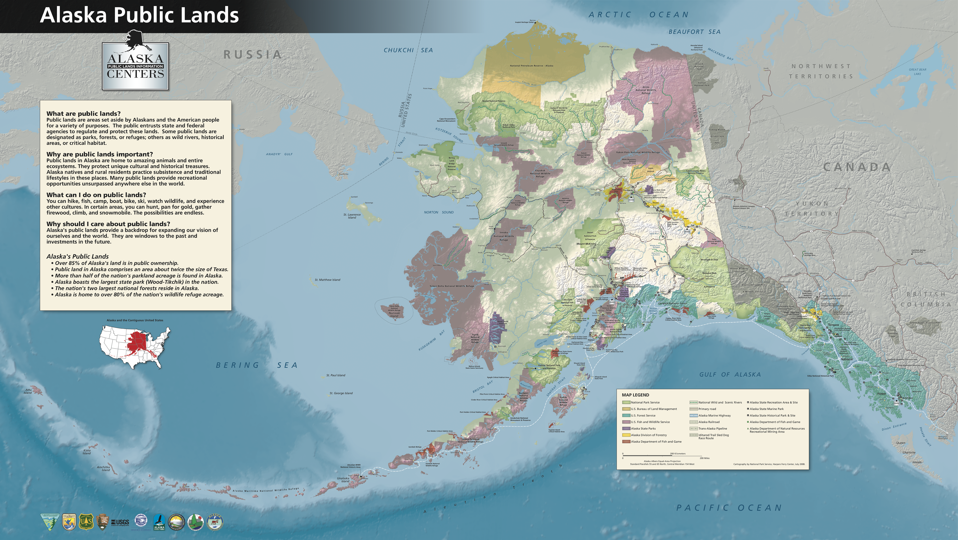

Slide 13
I traveled in China in 2001 and have long worked with the philanthropist Hansjorg Wyss. He recently donated $1 billion US to advance the Wyss Campaign for Nature.
Launched in October 2018, the Campaign for Nature calls on the nations of the world to commit to protecting 30% of their lands and marine areas by 2030 (“30 by 30”) at the Convention on Biological Diversity’s Conference of the Parties in October 2020 in Kunming, Yunnan.
The campaign works with the National Geographic Society, The Nature Conservancy and a growing coalition of conservation advocates to promote this commitment in order to provide a critical milestone toward preserving the half of the planet that remains in its natural state by 2050. It represents the best opportunity to protect the ecosystems critical to human survival.
我于2001年在中国旅行，并长期与慈善家汉斯约格·怀斯(Hansjorg Wyss)共事。他最近捐赠了10亿美元来推进维斯自然项目。
这个项目在2018年10月设立。将在2020年10月，昆明举办的生物多样性公约会议上呼吁各国家在2030前实现保护30%的陆地和海域的目标。
该项目与国家地理学会、自然保护协会以及越来越多的环保倡导者一起，旨在完成在2050前将半个地球交还给大自然的关键目标，以保护人类赖以生存的生态系统。

